Slide 1
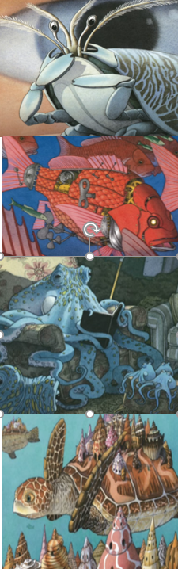
Flotsam Week 3 -Writing Lesson 2
WALT- Writing to Entertain.
TASK – So now the time has come to piece together all the ideas, Wagolls, examples, language, descriptions and plans you have created –and write your own Story.
You should use the following to help you:-
Look at the images from Flotsam again to inspire you.
Look at your setting ideas and descriptions – include the best parts of these in your opening.
Look at your character descriptions – Use the best parts of these when you introduce and describe your character
Speech by and about your character – use these examples throughout the story – where they fit best.
Your plan – make sure you have this in front of you as you write – you need to follow it and tick off the bits you’ve included as you go.
Language for impact – don’t forget that I want to see examples of impactful language and WOW words throughout the whole piece – not just at the beginning!
Good Luck – we cannot wait to read them – Remember to look back at the Wagolls from the other lessons to help you if you are stuck – I’ve attached some of them below to help you.

Slide 2

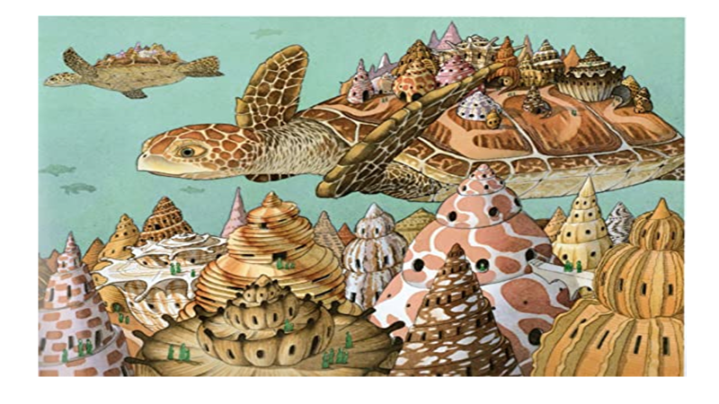
Patterned, iridescent, fragile
Chattering, calling hello across the waves
2) Look at your setting ideas and descriptions – include the best parts of these in your opening.
See
Spiral shells twisting
Hear
The gentle rush of waves and the tiny whisper of voices
Worn away by years of waves and sand
Hidden communities
2) See
Miniature houses
Touch
Ridges and smooth undersides
3) See
Floating shell cities
Memories
Meandering like streets
Smell
Briny salt tang
Reminding me of holidays strolling on ancient cobbled streets
Gently drifting with the tides
Like weekend chips by the seaside

Slide 3
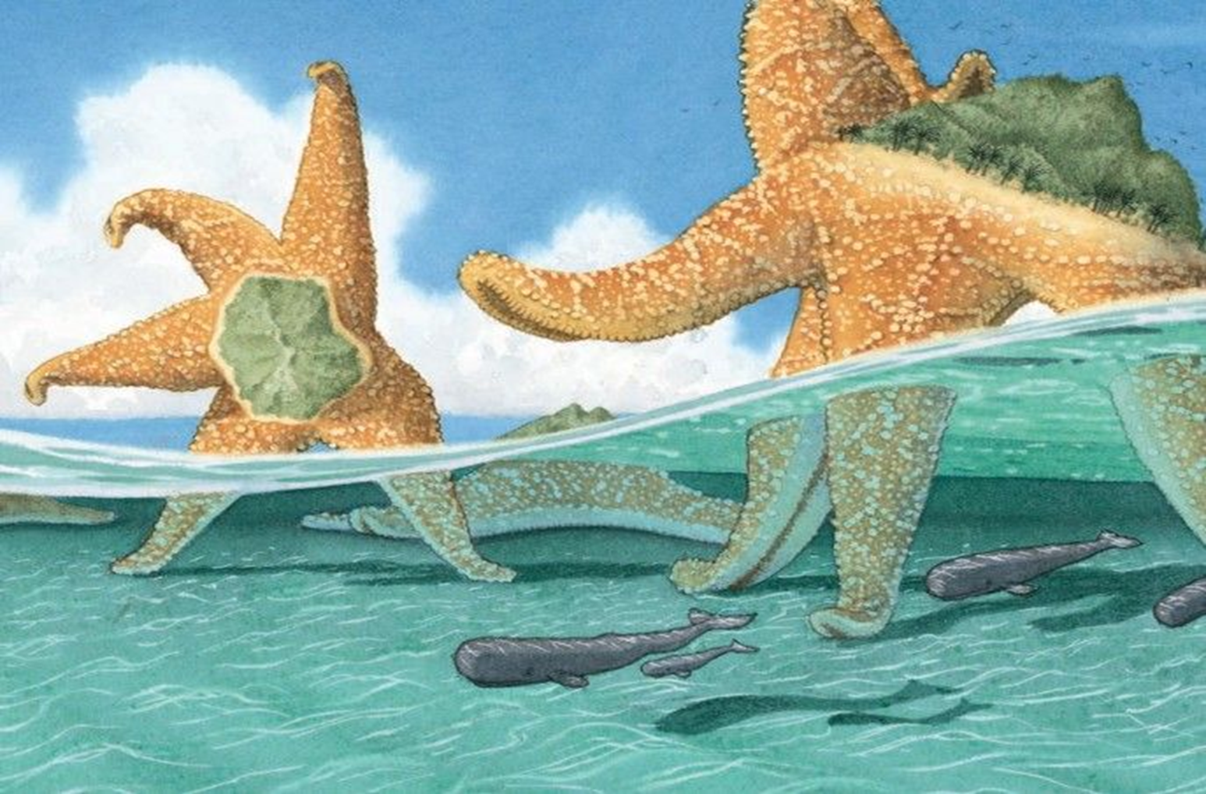
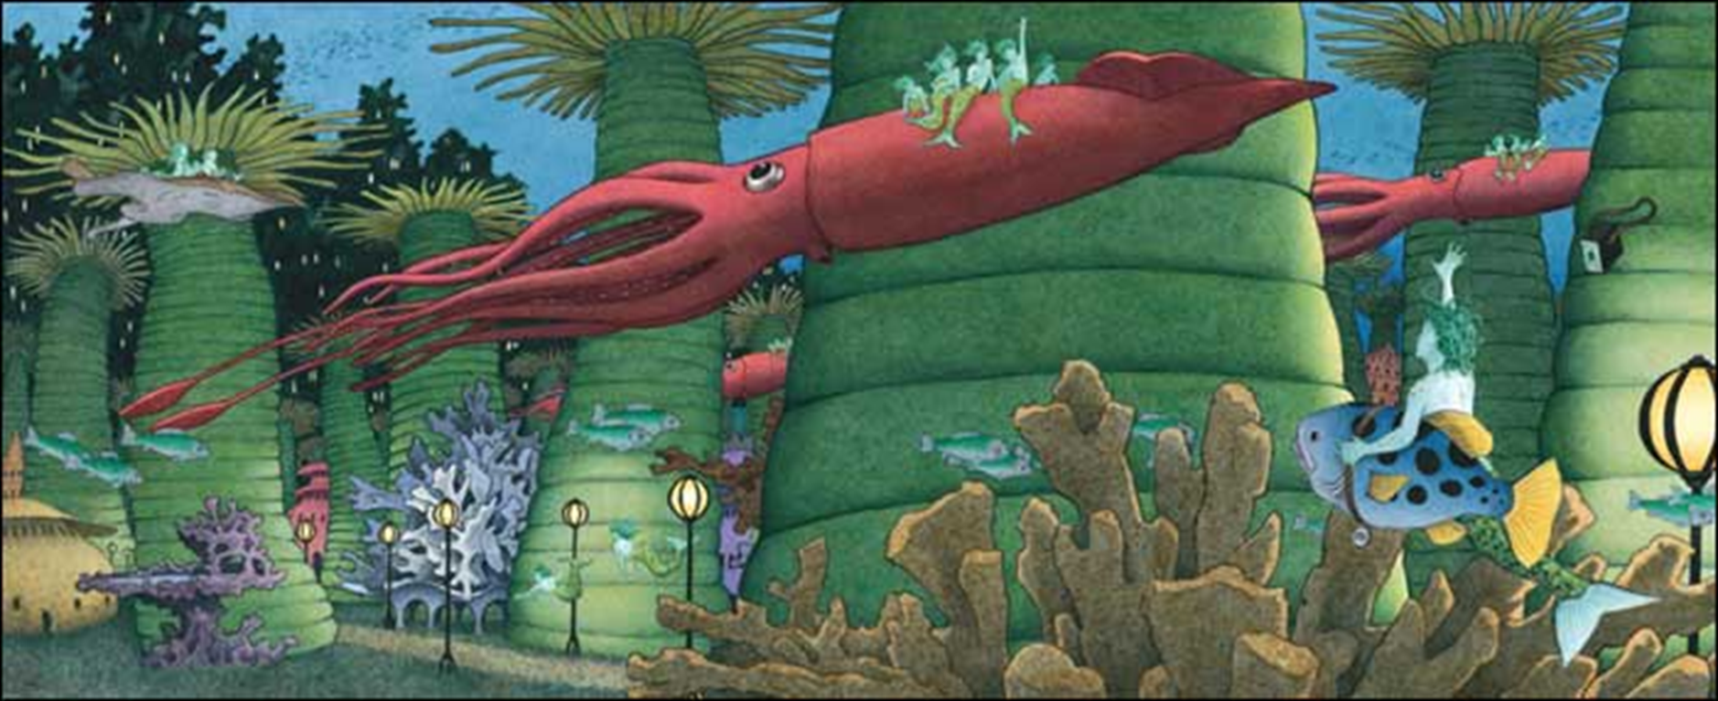
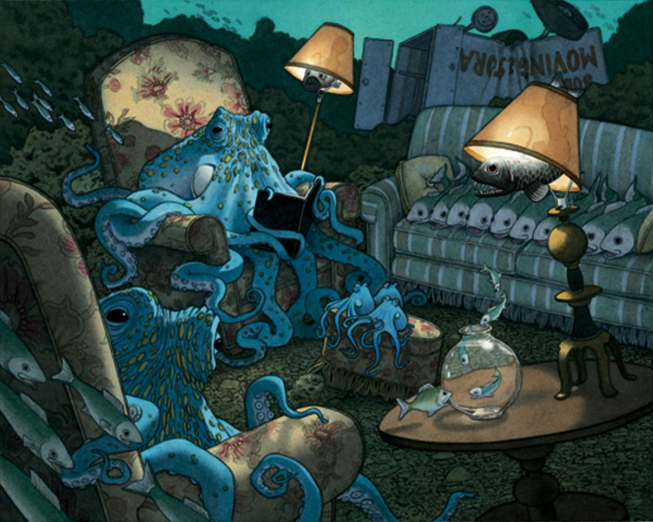
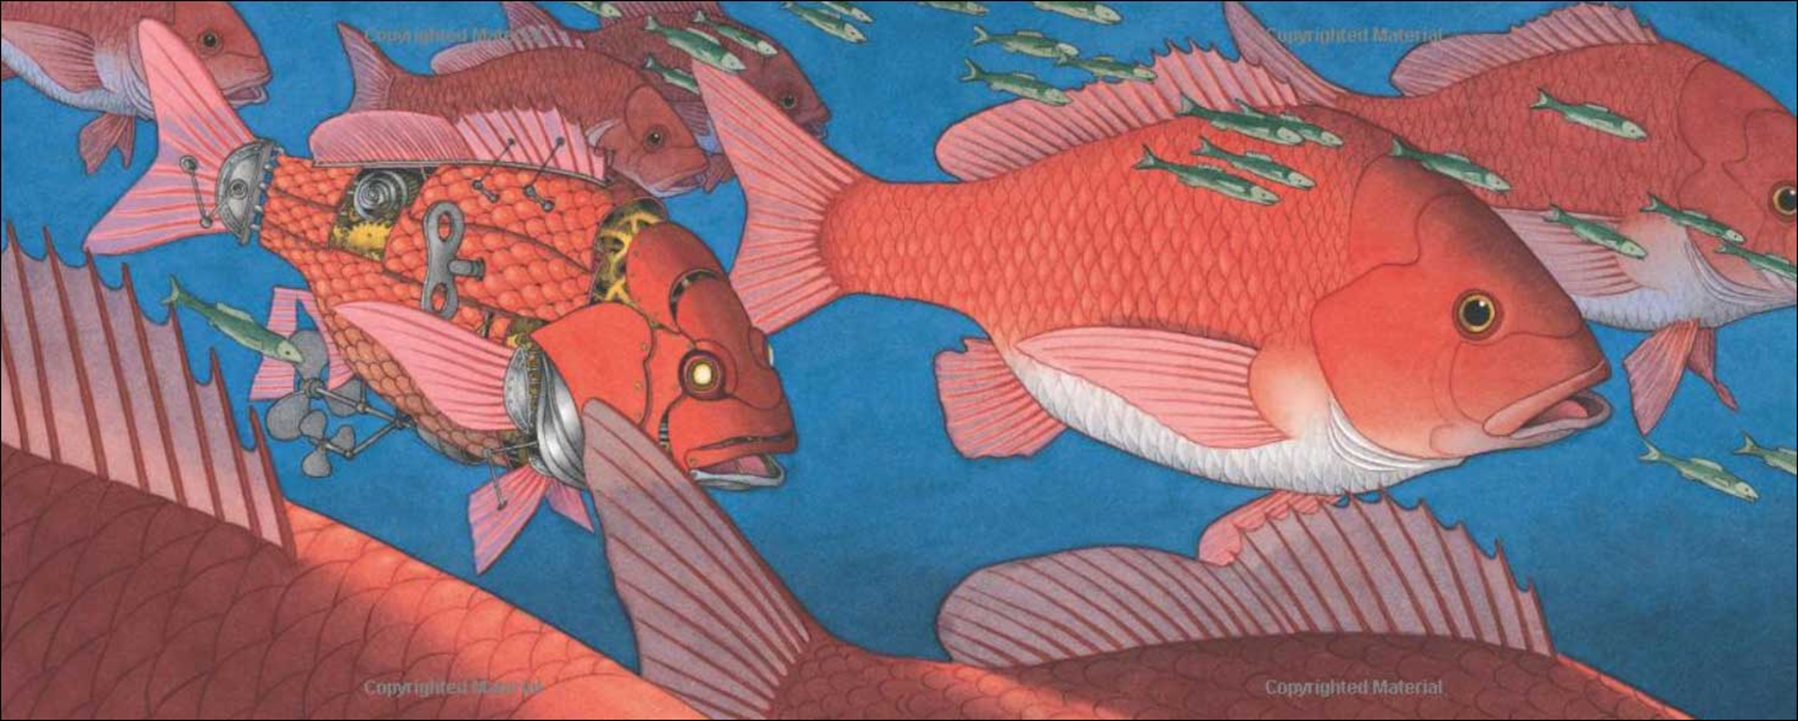
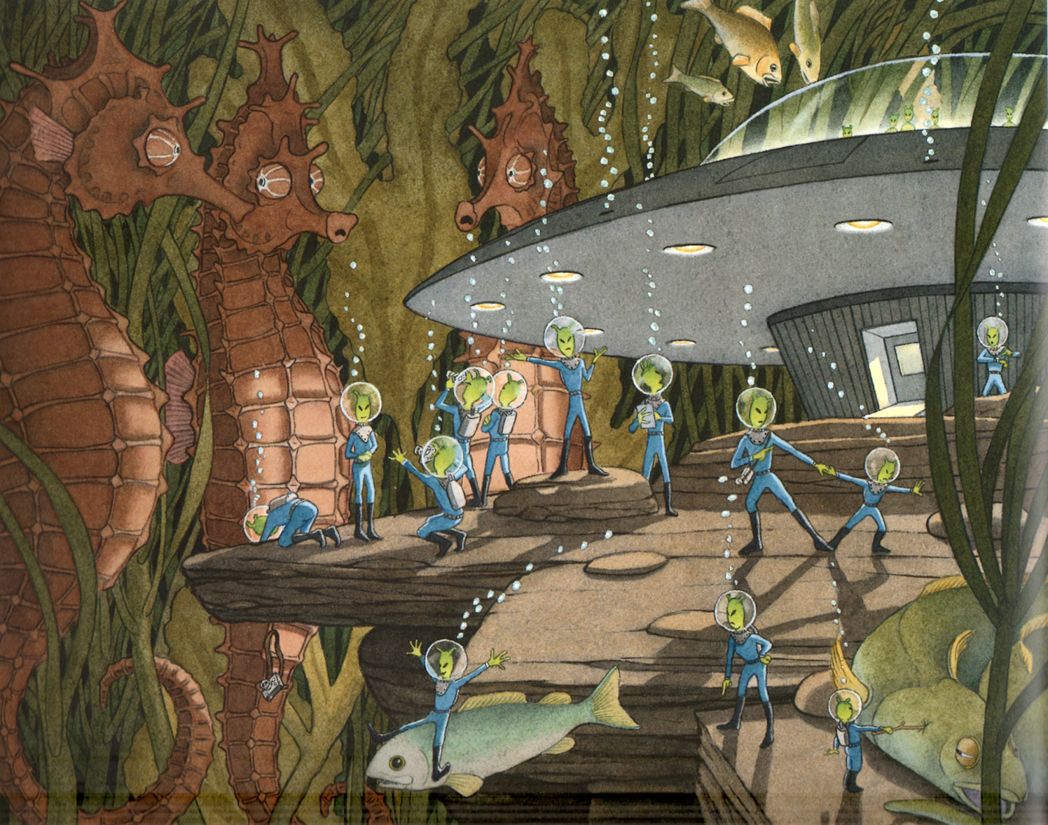
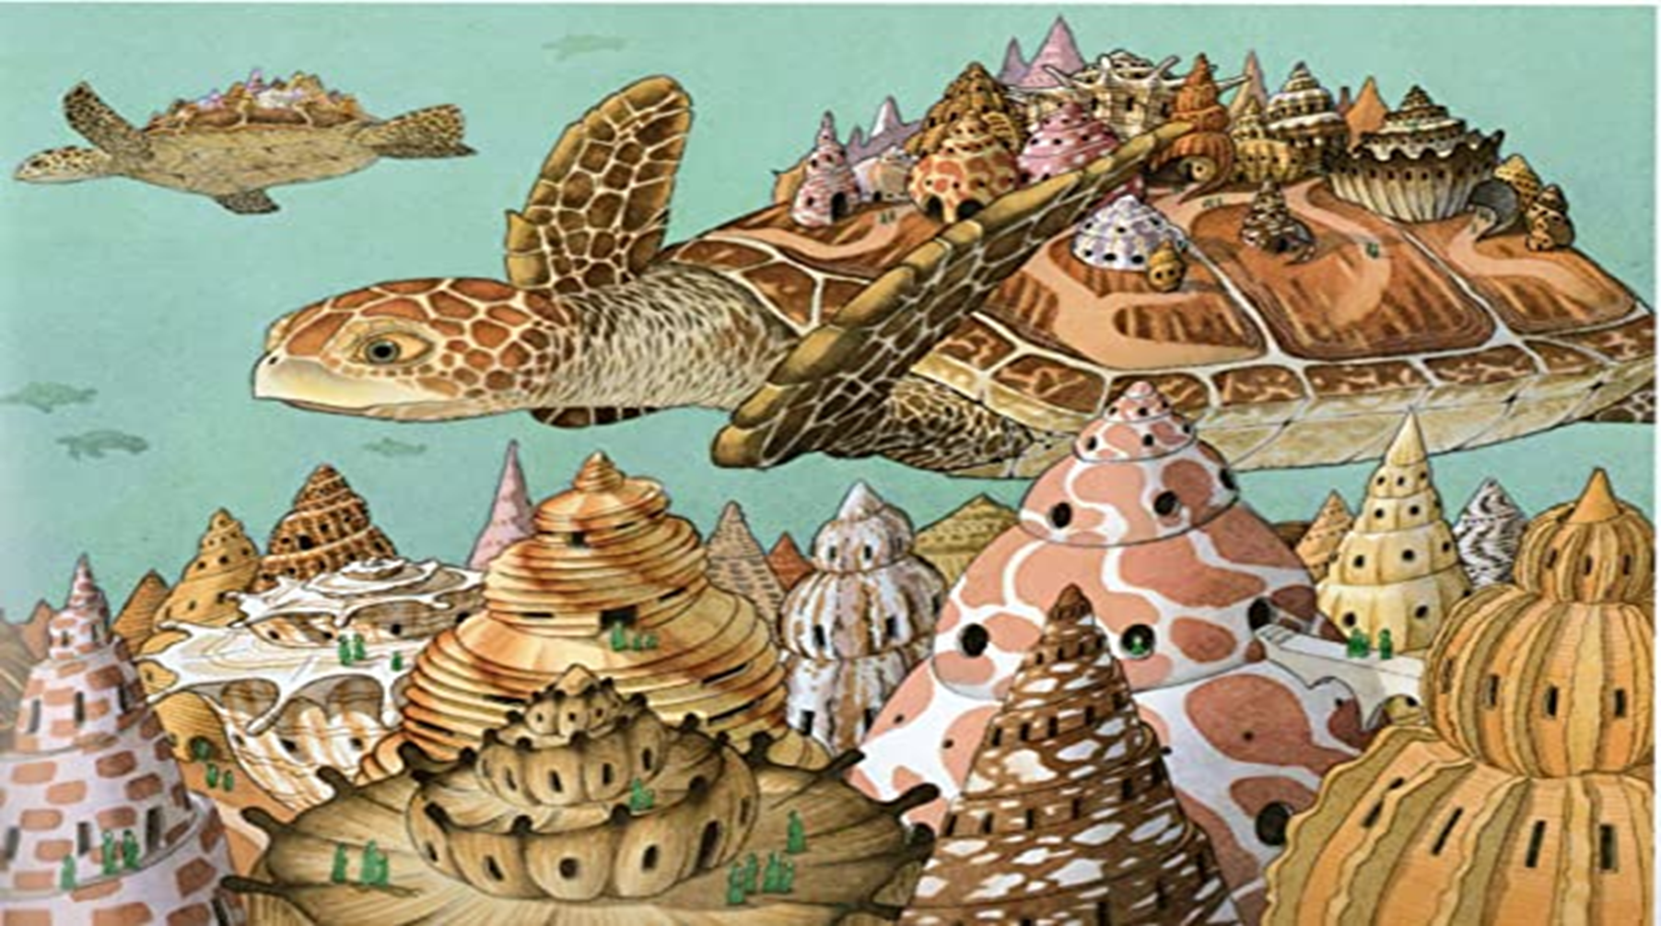
Look at the images from Flotsam again to inspire you.

Slide 4
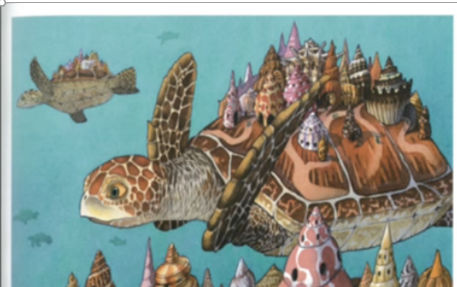
“He’s always drifting off somewhere!” Shelley moaned as she watched her brother float out of sight. As she gazed at him, it dawned on her just how very different they were. Not that you’d know it to look at them. They both had the same intricate, patterned shells - butter-smooth and worn by years of swimming and floating in the tides of the ocean. They both had the same intricate, hidden communities of miniature houses, hitching a ride across the oceans, on the contours of their shells. They both had the same leathered skin and wrinkled laughter lines that their many, many years had brought them. But inside those shells lived the hearts and minds of two completely different souls.
Ridge was a dreamer. He floated on the tide, drifting from one place to another without a care in the world. His philosophy was always the same and he repeated the same mantra each time he was reprimanded by his sister for being late;
“It’s cool sis – no worries! Just go with the flow! Don’t get hung up on time and tide – we are all just following the current of life – stress not!”.
This – of course was at complete odds to the way Shelley viewed the world. She worried and fussed endlessly (some might say too much) about the needs and cares of her shell inhabitants. She worried about their food, their sleep, their shell maintenance – in fact there was very little that didn’t worry her.
The differences between the two turtles could not have been more pronounced. Ridge the care-free bird of the sea – gliding though life oblivious to others. And Shelley – the anxious, fraught worrier – wound up as tightly as a spring. And it was in the tale of how they learned to overcome these very differences, that we were to learn who they truly were…
3) Look at your character descriptions – Use the best parts of these when you introduce and describe your character

Slide 5
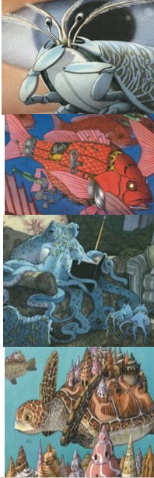
1). An example of the character speaking themselves – giving subtle clues to their personality.​
“Settle down, settle down children. I have a new exciting story for you today.” Grandpa Octopus beamed as he dramatically opened his book of bedtime tales. “You’re going to love this one, it’s all about my greatest adventure!”.
4) Speech by and about your character – use these examples throughout the story – where they fit best.
2). An example of someone else speaking about your character – discussing what they are like or what they think of them.​
“Move up, I want to listen too!” Whispered baby fish as he tried to squeeze through the throng of eagerly anticipating youngsters.
“Shh!” Replied the young octopus, “he will hear you! You know how grumpy he gets when he thinks are not listening. Besides, I don’t want miss a word – today he is finally going to tells us all about the time he was caught and managed to escape from pirates!”
3). An example of a narrator discussing the character and speaking directly to the reader about them – giving us details of what they are like.​
Grandpa paused dramatically as he glanced around the eager young faces. To look at him today, you may not have believed that this kindly, caring grandfather figure could ever have taken on pirates and won, but he was not always the gentle soul he appears today! So sit back and listen carefully, if you want to know the real truth about Grandpa Octopus!

Slide 6
5) Your plan – make sure you have this in front of you as you write – you need to follow it and tick off the bits you’ve included as you go.
Character:-
Grandpa Octopus – kindly figure – cares about all young creatures and loves to read bedtime stories. Stories linked to his past adventures – rumours of links with pirates in the past!
3) Character tries to solve problem – lots of action and speech:-
Sets out on one last adventure into the ocean to find his beloved book – joined by his best friends the Angler fish and Turtle. They revisit and relive old memories and adventures as they go back to places from their past.
Lots of speech and action – dialogue between friends, using sentence starters to jump action forward e.g. after many days etc.
Setting:- Grandpa’s living room – getting ready for story time – all the fish begin to arrive – cosy settled in atmosphere
2) Problem arises – something simple and related to the setting/character:-
Everyone is ready, all settled and ready to begin but he can’t find his book! Looks everywhere and it is no where to be found. Disappointed baby fish have to go to bed without their story – Grandpa is devastated. The evening is ruined – Grandma tries to comfort Grandpa but he cannot sleep – he must find his book!
Include thoughts, emotions and speech of characters.
4) Problem solved – possibly by a new character:-
They return home after visiting all the many sites of their adventures and remembering all they had seen and done over the years. Grandpa goes to sleep, exhausted and disappointed at not finding his book. He awakes in the morning to a wrapped parcel delivered by the post fish. He unwraps it excitedly – wondering if it could be his old book – it isn’t and initially he is disappointed but then he looks inside and reads the inscription – it is a gift from his friends Turtle and Angle fish – they have written down accounts of all the many adventures they remembered together on their trip – so at last Grandpa has a new and even better book of stories to share!
Include emotions and thoughts of character and description of book
Opening – ordinary day – life is normal:-
Describe the evening falling in the ocean, all the young creatures get excited for grandpa octopus’s bedtime stories. All arrive. Describe scene, cosy, settled anticipation..
Metaphor and similes to describe scene and speech to describe Grandpa – his and the fish around him. Use narrator’s voice to hint to past adventures.
5) Back to normal life – possible links to opening:-
Return to first scene – fish all listening to grandpa’s tales and enjoying the new bedtime stories – ends with baby fish saying how much he prefers the newer, more exciting tales about Grandpa Octopus and with the mummy fish complaining that they will never get their babies to sleep now- it’s all far too exciting!
Use speech about characters and Narrator speaking directly to reader to end.

Slide 7
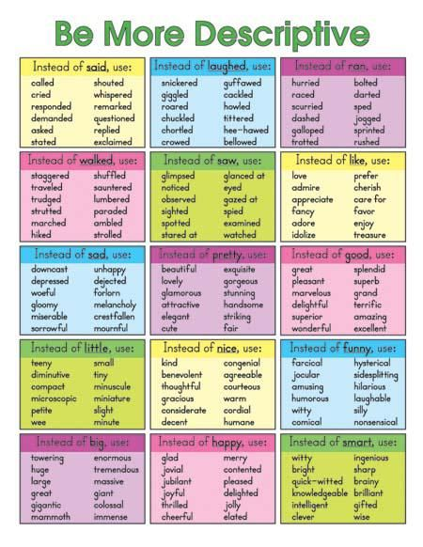
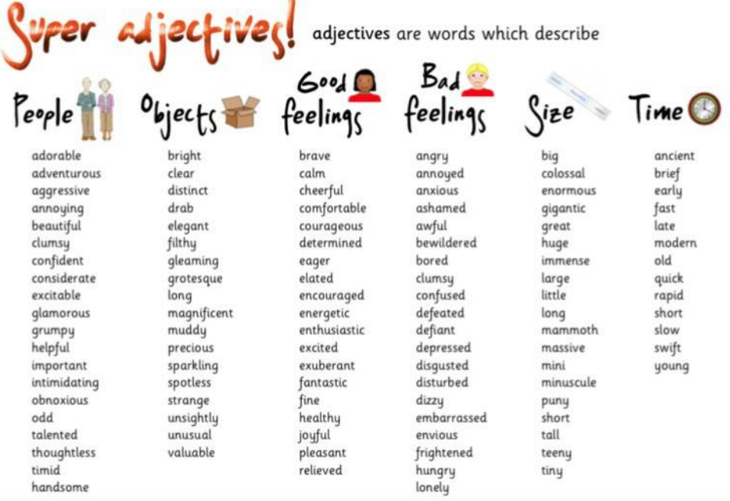
6). Language for impact – don’t forget that I want to see examples of impactful language and WOW words throughout the whole piece – not just at the beginning!

