Slide 1
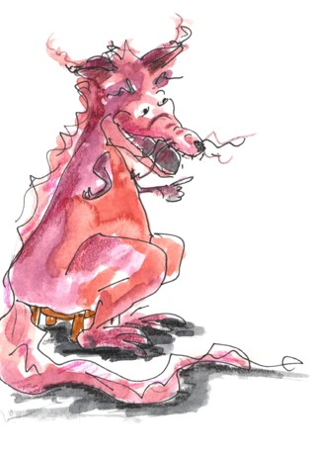
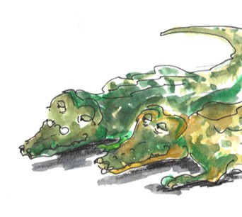
Punctuating Direct Speech
The Red Gold Dragon
What do you guys want?
We would like you to tell us a story.

Slide 2
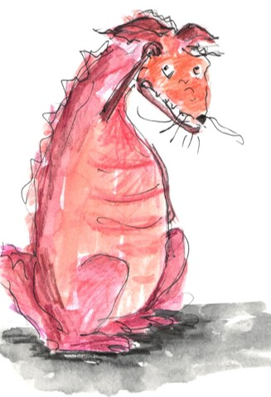
Punctuating Speech
Speech bubbles can show us what a character is saying.
Okay, I’ll tell you a story.
The words said are called direct speech.
“Okay, I’ll tell you a story,”
said the Red Gold Dragon.
Bubbles take up too much room when we are writing, so we use speech marks.
Speech marks work in pairs to hug the direct speech.
We report who is speaking using a reporting clause.
Speech marks are also called inverted commas.

Slide 3
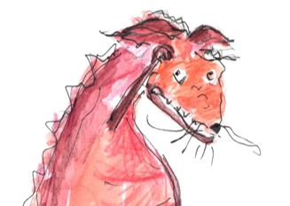
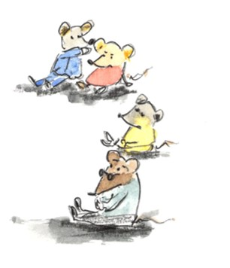
Punctuating Speech
Red Gold
Dragon
I can tell brilliant stories.
“I can tell brilliant stories,” boasted the dragon.
“You didn’t tell us a story!” squeaked the mice.
You didn’t tell us a story!
EXAMPLE
Mice
Write this conversation as punctuated speech.
Remember to hug the direct speech with speech marks
and add reporting clauses.

Slide 4
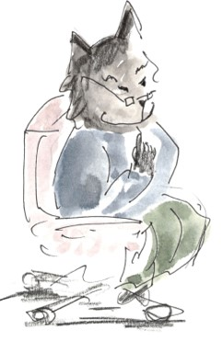
Punctuating Speech
“Don’t be mean to the Dragon,” said the Cat, peering at them over the top of his glasses.
“Okay! Okay!,” squeaked the Mice, who were slightly ashamed of their outburst.
EXAMPLE
You can also add actions and descriptions.

Slide 5
Punctuating Speech – capital letters open direct speech
Direct speech begins with a capital letter, even if it is in the middle of a sentence.
The Red Gold Dragon explained, “It is normally fine – it was just this once.”
The Cat responded, “Yes and that’s why you came to me.”
It is the beginning of the speaker’s sentence so a capital letter is used.

Slide 6
Punctuating Speech – commas separate clauses
Direct speech and reporting clauses are usually separated by a comma.
“I am very happy that it all worked out,” sighed the cat.
The dragon smiled, “So am I!”
The comma is placed at the end of the first clause.
The speech marks follow the comma.

Slide 7
Punctuating Speech – exclamations and questions
If the speech ends in a ! or ? we do not need a comma after the speech.
“What story shall we ask the dragon for?” asked the Crocodiles
“The Little Story, of course!” shrieked the Mice.
The punctuation is placed inside the speech marks.
The punctuation belongs to the spoken words – they tell you how to say them.

Slide 8
Punctuating Speech – a new line shows a change of speaker
I keep my stories in my golden heart.
“I keep my stories in my golden heart,” said Dragon.
That’s a good place to keep them.
“”That’s a good place to keep them,” commented the Mice.
“It’s always been fine,” sighed the Dragon.
It’s always been fine.
The Mice squeaked, “Well, now we want a story!”
Well, now we want a story!
We show each change of speaker by starting a new line.
This makes it clear when the speaker changes.

Slide 9
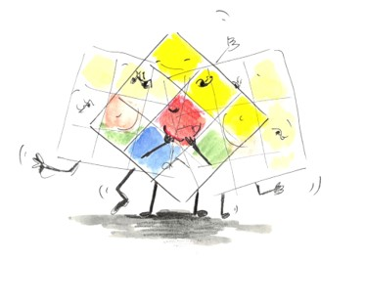
Punctuating Speech – Your Turn
Write some new dialogue for the Dragon and the Cat.
“The little Mice started it,” said the Red Gold Dragon, sighing deeply.
Hug the words spoken with speech marks
Start the speakers’ words with a capital letter
Separate the speech and reporting clause with a comma
Include some action or description
Start a new line to show the speaker has changed
The Cat listened with great patience, and then remarked, “I think you have already told the story.”
“I have been told!” shrieked the Little Story, happily, bouncing up and down.
“And you were brilliant!”
said the Red Gold Dragon.

Slide 10

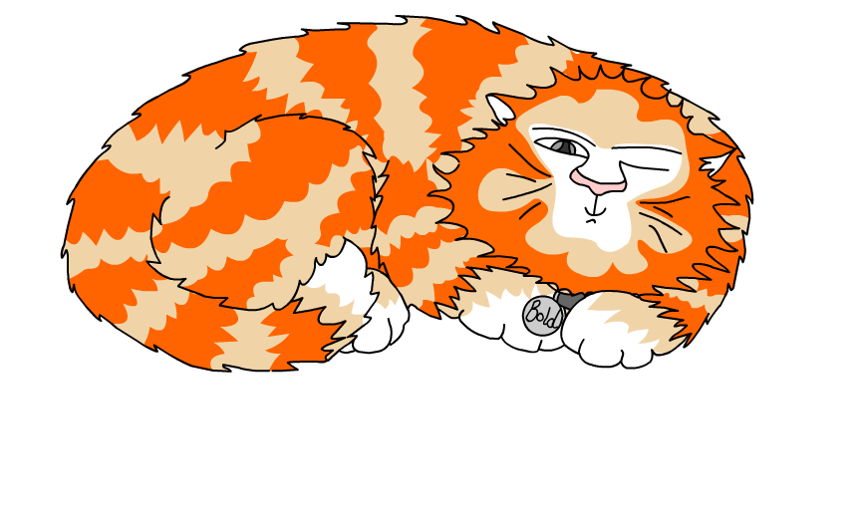
Explore more Hamilton Trust Learning Materials at https://wrht.org.uk/hamilton/ .

