Slide 1
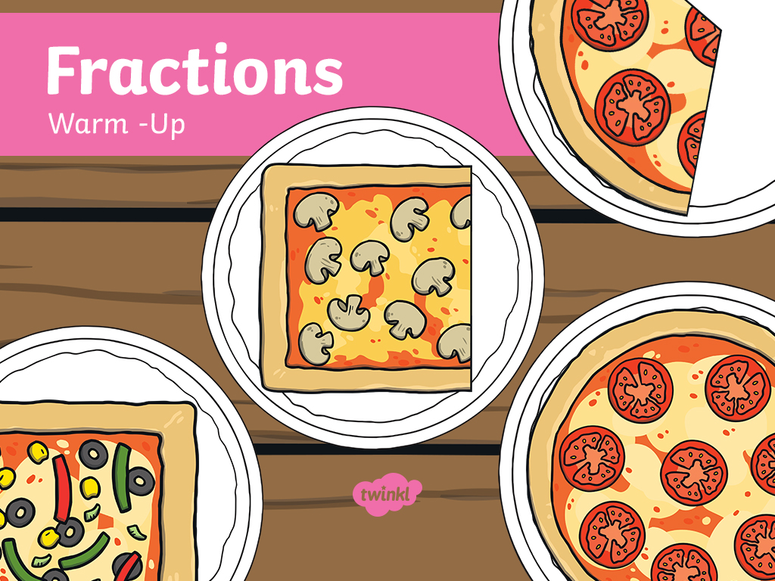

Slide 2
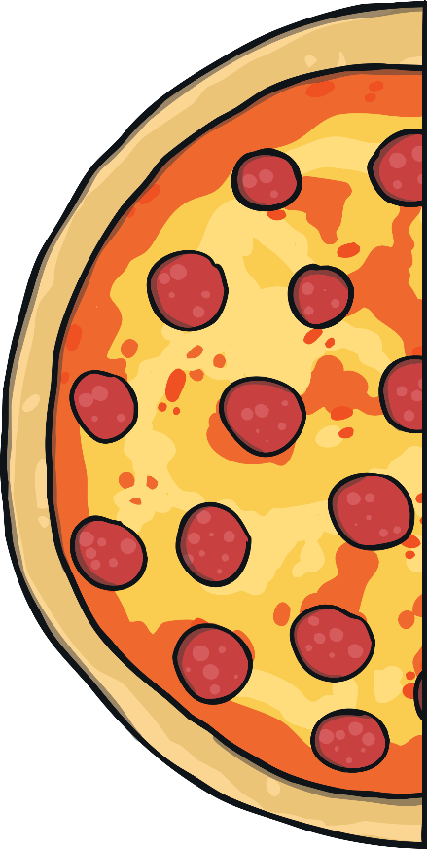
Is it a half?
answer
Yes, it is a half because it is divided into two equal parts.

Slide 3
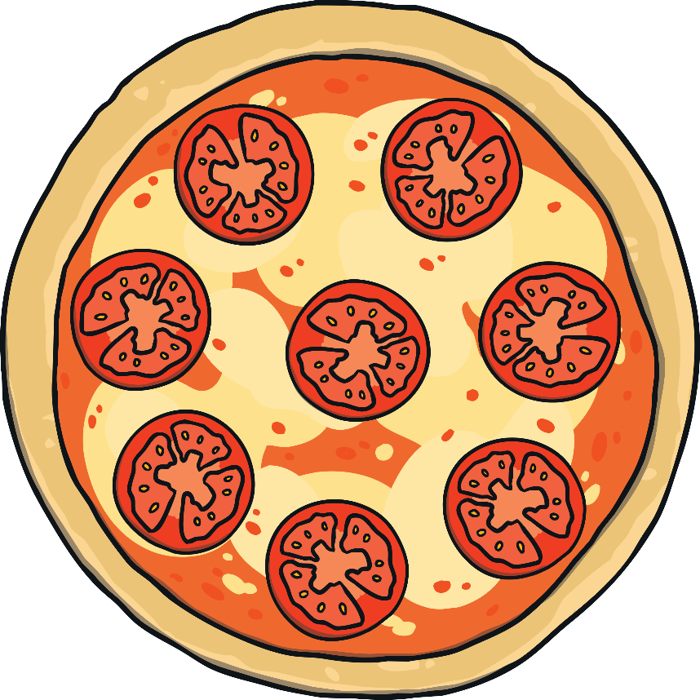
Is it a half?
answer
No, because it’s a whole shape.

Slide 4
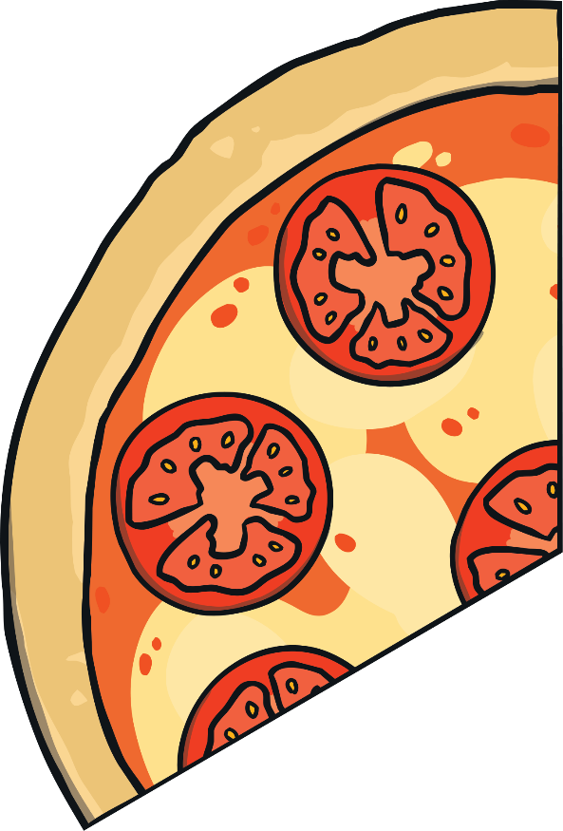
Is it a half?
answer
No, because the parts are not equal.

Slide 5
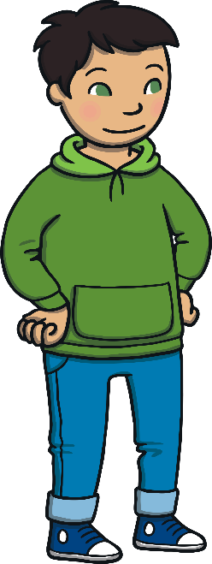
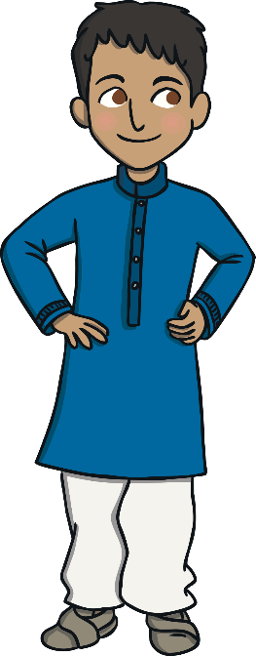
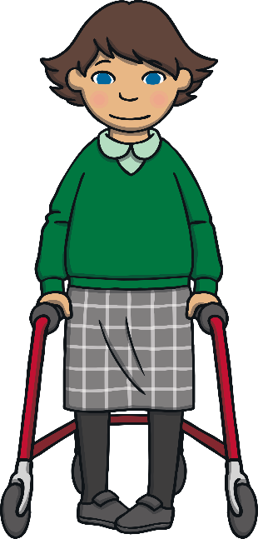


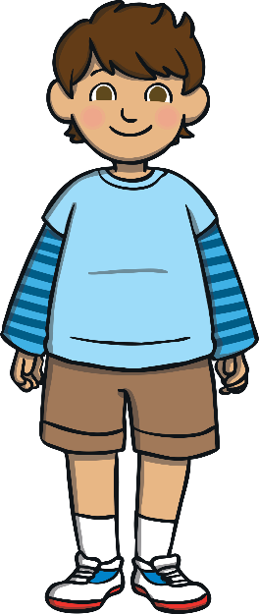
Is it a half?
Half of the class are girls.
There are 6 girls.
How many children are in the class altogether?
12
answer

Slide 6
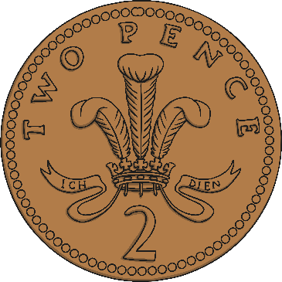
Halve It!
What is half of this amount?
4p
answer

Slide 7
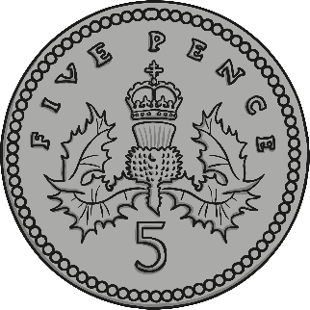
Halve It!
What is half of this amount?
5p
answer

Slide 8

Halve It!
What number is
half of 10?
5p
answer

Slide 9

Halve It!
What number is half of 12?
6p
answer

Slide 10

Halve It!
What number is
half of 20?
10p
answer

Slide 11
Is it a quarter?
answer
Yes, because it is divided into four equal parts.

Slide 12
Is it a quarter?
answer
No, because it is not divided into four equal parts.

Slide 13




Is it a quarter?
Ruby shared 8 sweets into 4 party bags.
How many sweets were in each party bag?
2
answer

Slide 14
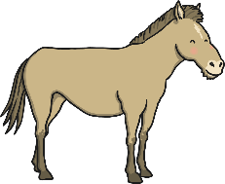
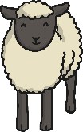
Is it a quarter?
Share the animals equally into the pens.
How many animals are in each pen?
answer
3 sheep and 1 horse

Slide 15
