Slide 1
CHANGES IN CHICHESTER
OVER 100 YEARS

Slide 2
Who can think of any changes in Chichester?

Slide 3
What do you think
Chichester was like 100 years ago?

Slide 4
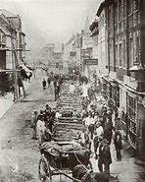

Slide 5
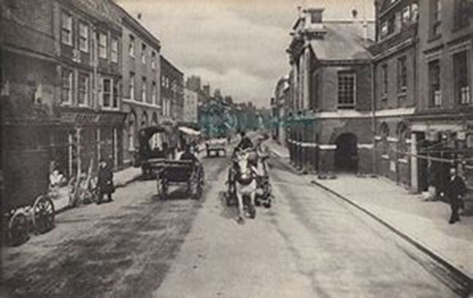

Slide 6
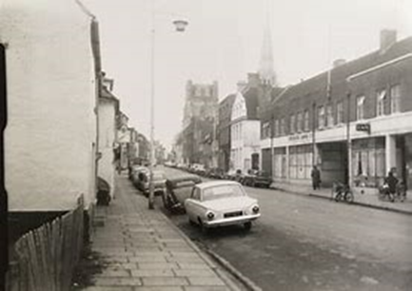


Slide 7
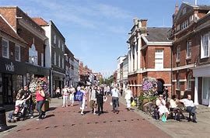

Slide 8
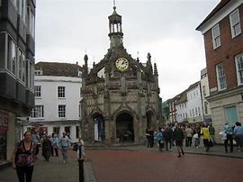

Slide 9

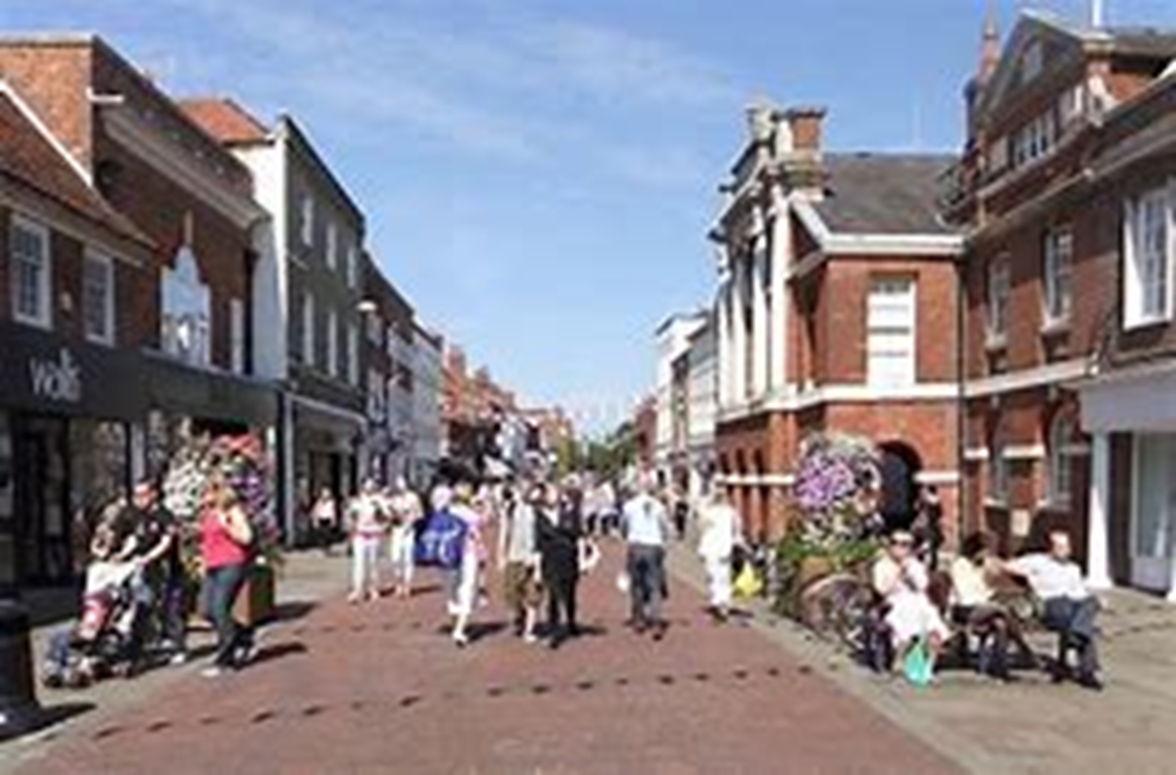
How can we describe the changes?

Slide 10

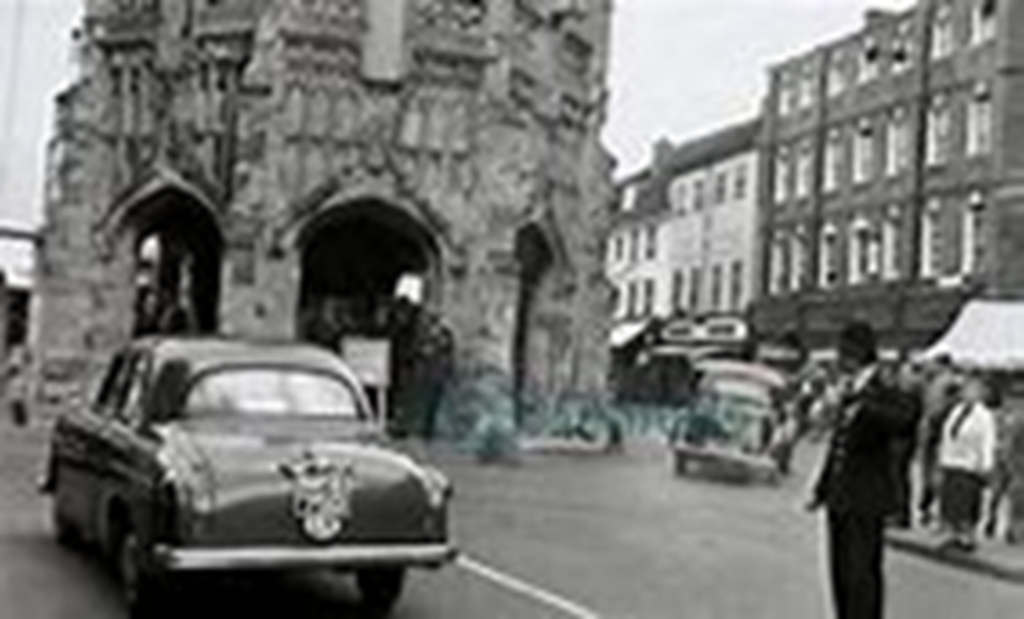

Slide 11
What language can we use?
Before
Then
Around 100 years ago
Differences

Slide 12
TASK
Write about the similarities and differences in Chichester
What are the biggest differences you notice?
Can you work out which streets these are in Chichester?
What do you notice about the transport?
What do you notice about the buildings?
There is a sheet attached that you might want to use.

