Slide 1

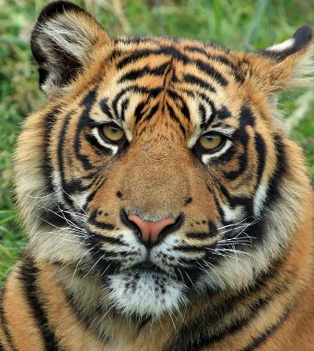
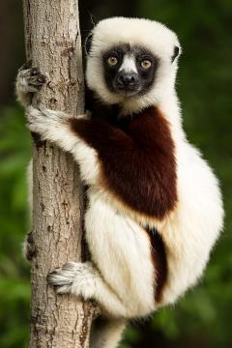
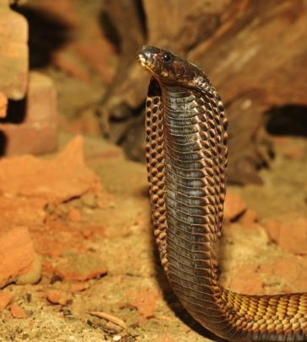
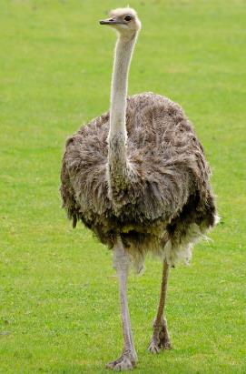
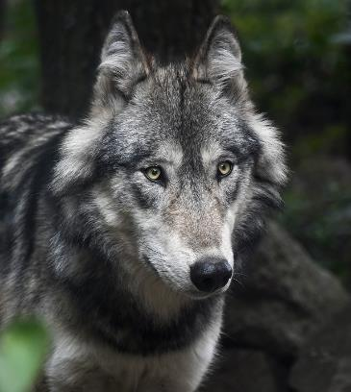
Adverbials and Fronted Adverbials
Animals in Captivity
What do you think these animals have in common?
They are registered exotic pets in the UK.

Slide 2
Adverbials and Fronted Adverbials
Animals in Captivity
In the UK, thousands of exotic animals live as pets in family homes.
Surprisingly, these pets include crocodiles, lemurs and tigers.
Often, owners choose them for their beautiful appearance.
Without meaning to, people can cause distress to their pets.
Some animals struggle with human owners.

Slide 3
Adverbials
Adverbials tell us more about a verb.
Adverbials can be
a word,
a phrase,
or a clause.
unfortunately
in the wild
as they adapt to captivity

Slide 4
Adverbials
Adverbials answer the questions…
Where?
Tigers hunt in the wild.
Adverbials tell us more about a verb.
When?
Tigers hunt at night.
How?
Tigers hunt with cunning.

Slide 5
Adverbials can be placed before and after the main clause.
Lemurs forage.
For much of the day, Lemurs forage in the wild.
With nimble fingers, lemurs forage for fruit and small insects.
Up in trees, Lemurs forage with others nearby.
When an adverbial appears in front of the sentence it is modifying…
it is called a fronted adverbial.
Fronted adverbials are punctuated by a comma.

Slide 6
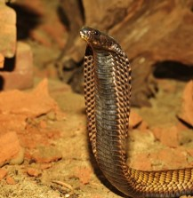
time
place
manner
Adverbials
before
after
while
in
on
at
until
above
below
inside
outside
to
on
from
by
across
under
in
with
as
like
Adverbials often open with a preposition.
Some snakes can adapt to life in captivity.
They live in special heat-controlled tanks.
As wild animals, these pets require special food.
You can look for prepositions to help you spot some adverbials.
The preposition is part of the adverbial.

Slide 7
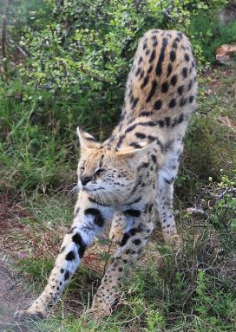
time
place
manner
Adverbials
before
after
while
in
on
at
above
below
inside
outside
to
on
from
by
in
with
as
like
for
Can you spot the adverbials in these sentences?
Servals are very active hunters in the wild.
Sometimes servals are mistaken for domestic cats.
They can leap from standstill to catch birds.
HINT: Look for the main clause and find the verb.
The adverbial will be modifying it.
ANSWERS

Slide 8
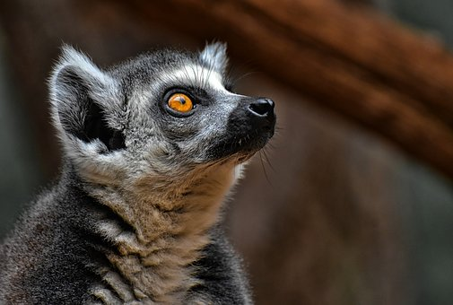
Adverbials add detail
How did the added detail change the emotion you felt?
Adverbials add more information about a verb. The sentence will still make sense without it.
the lemur stared
through the steel bars
at the bored tourists
with love for her child

Slide 9
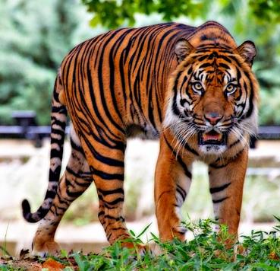
Adverbials add detail
Try adding different adverbials to this clause.
What is the impact?
The verb has not changed but our perception of it has.
This is a powerful way to make writing persuasive!
Adverbials add more information about a verb. The sentence will still make sense without it.
the tiger paced
like a thing of magic
,
What would you use to make someone feel admiration for the tiger?
What would you use to make the tiger seem scary?
What would you use to make someone feel sorry for the tiger?
at the dead of night
in deep frustration
with menace in its heart
with powerful grace
on tired paws

Slide 10

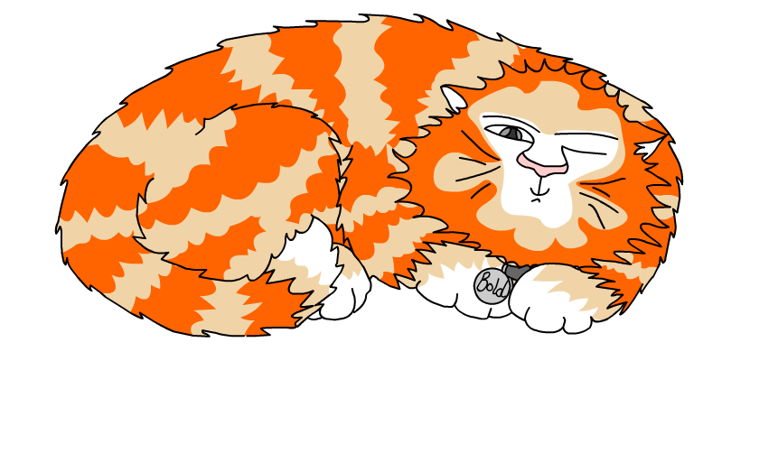
Explore more Hamilton Trust Learning Materials at https://wrht.org.uk/hamilton/ .

