Slide 1
Home Schooling Made Easy:
Planning for weekly mini-topics

Slide 2
Some practical points
Some of the activities in this Powerpoint are dependent on being able to print some resources from Twinkl. Not everyone will have access to a printer. There will be lots of ways you can tweak activities or just show the information on a computer / laptop / ipad screen.
I’ve listed other practical resources needed but obviously again, not everyone has access to these resources. Perhaps that’s where friends and neighbours could safely be asked or perhaps in your online community groups.

Slide 3

Twinkl
A lot of resources we use come from Twinkl because they have such a variety of Powerpoints, work sheets and practical resources.
Twinkl are amazingly doing a months free membership:
www.twinkl.co.uk/offer
enter the code: PARENTSTWINKLHELPS

Slide 4
Home Schooling
Week 3
Easter

Slide 5
Activities and Resources for this week
 | Activity | Resources
Monday | The Easter Story – making an Easter garden | Tray, soil, stones, grass
Tuesday | The odd egg | Colouring pencils
Wednesday | New Life | Paper plate (or cut out circle), straw / string, paint, googly eyes,
Thursday | Easter cross craft | Food colouring, kitchen roll
Friday | Egg fun | Food colouring, eggs, vinegar, bicarbonate of soda

Slide 6
Monday
The Easter Story

Slide 7
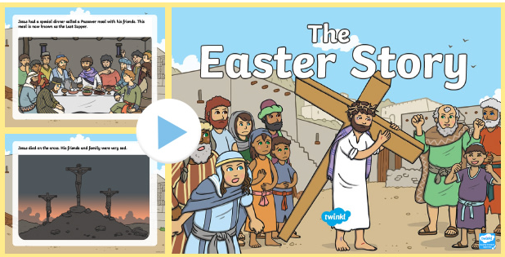
LEARN
Key Stage 1:
Read through this powerpoint of the Easter story here on Twinkl.
If full web page doesn’t appear, click on the green ‘Download Now’ icon on the web page and the resource will download correctly.

Slide 8
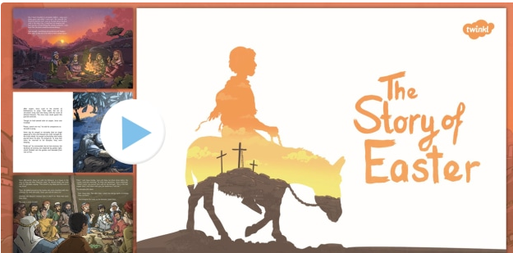
LEARN
Key Stage 2:
Read through this powerpoint of the Easter story here on Twinkl.
If full web page doesn’t appear, click on the green ‘Download Now’ icon on the web page and the resource will download correctly.

Slide 9
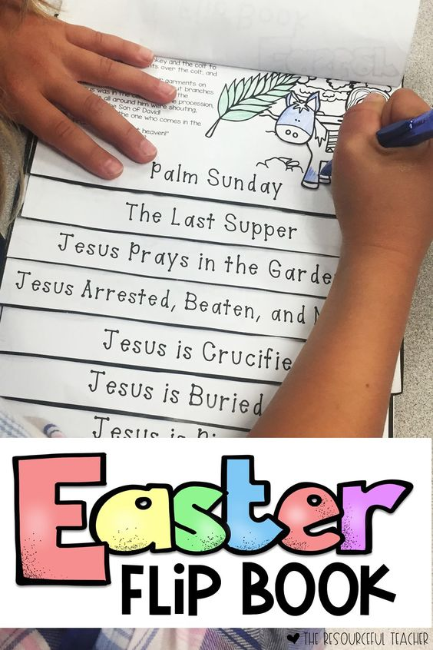
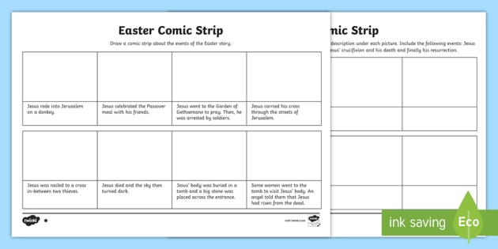
PRACTICE
Key Stage 1:
Fold a piece of paper into 6 or 8 pieces and make a comic strip of the Easter Story. Add a sentence with each picture. Or templates can be found here on Twinkl.
Key Stage 2:
Make an Easter flip book. Each page is a different key part of the story. You can put in as many or as few key parts to the story to suit different ability children.

Slide 10
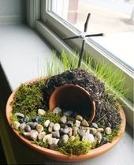


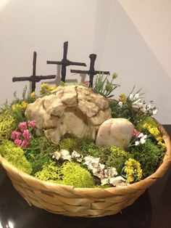
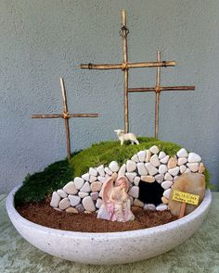
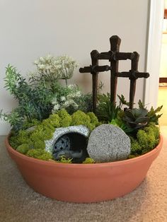
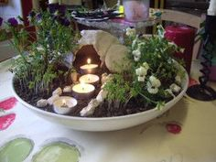
PRACTICAL
Key Stage 1&2:
Make an Easter garden to show Jesus’ tomb.

Slide 11
Tuesday
The Odd Egg

Slide 12

LEARN
Key Stage 1&2:
Look at the story of the Odd Egg which can be found here on YouTube.

Slide 13

PRACTICE
Key Stage 1:
Get the children to design their own egg then think of adjectives such as shiny, rough, unusual etc to describe the egg. The children have been beginning to use thesauruses in school and could do this if you have one at home.
Alternatively there are lots of online thesauruses they could use. They can then write sentences about the egg using adjectives and comas. ‘The rough, vibrant and peculiar egg rolled down the steep hill.’
Egg templates can be downloaded here on Twinkl.

Slide 14

PRACTICE
Key Stage 2:
Create a creature that breaks out of the egg. It could be a real animal or a made up animal.
They can then write a descriptive paragraph about the creature they have drawn. Here’s an idea to get them started.
‘Out of the egg poked an orange, pointy nose that began sniffing the air. In a split second, two stubby arms shot out of each side of the egg and two flippers out of the bottom. The peculiar egg wobbled from side to side and spun round and round in circles until finally out of the egg burst a tiny but very angry creature. Every part of the creature body was a different colour and at a glance looked like a walking rainbow…’

Slide 15
Wednesday
New Life

Slide 16
LEARN
Key Stage 1&2:
Watch a chick hatching here. Remind children that soon after the chick hatches, it dries and goes fluffy!
https://www.youtube.com/watch?v=SyO3YwrsJPg

Slide 17
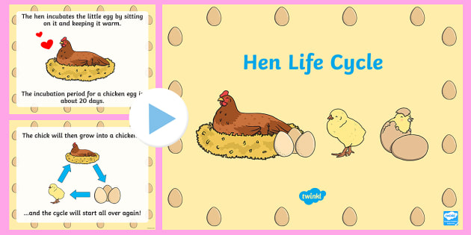
LEARN
Key Stage 1&2:
Look at this Powerpoint to learn about the life cycle of a chicken here on Twinkl.

Slide 18
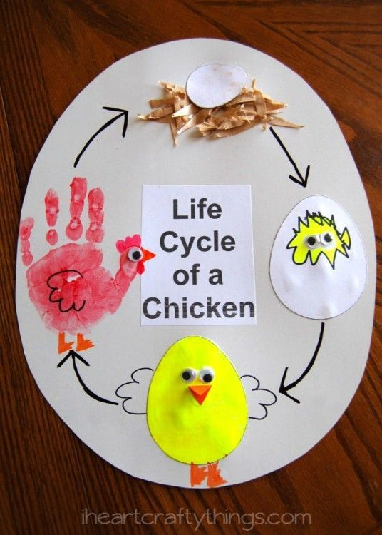
PRACTICE
Key Stage 1:
Use a paper plate (or a round piece of card) to create a chicken life cycle. A hand print can be used for the adult chicken. Sting or straw can be used for the nest! If you’ve got some googly eyes, use those too!

Slide 19
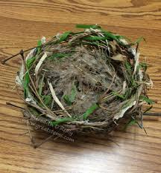
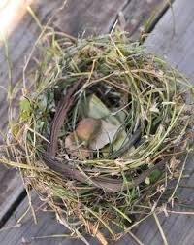
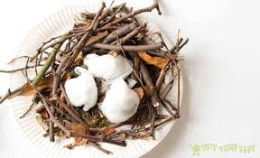
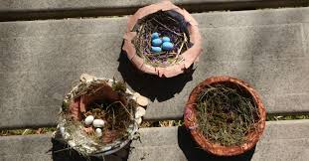
PRACTICAL
Key Stage 1&2:
Build a nest! Watch a time-lapse video of a bird building a nest. Use grass cuttings, stray, twigs… anything you can get your hands on to build a bird nest. Use mud/clay to line the inside!

Slide 20
Thursday
Craft Day

Slide 21
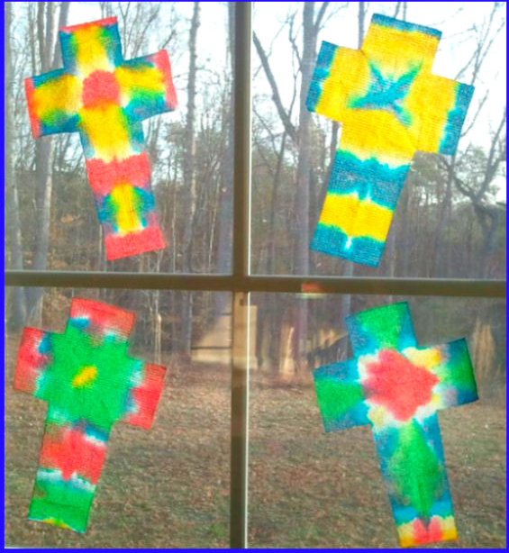
CRAFT
Make crosses using kitchen roll and food dye. Instructions can be found here.

Slide 22
Friday
Egg Fun

Slide 23

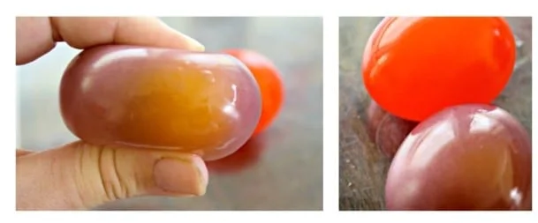
PRACTICAL
Key Stage 1&2
Follow this link to find instructions on making fizzy eggs with food colouring!
Alternatively, make bouncy Easter eggs by following this link to find the instructions.

