Slide 1
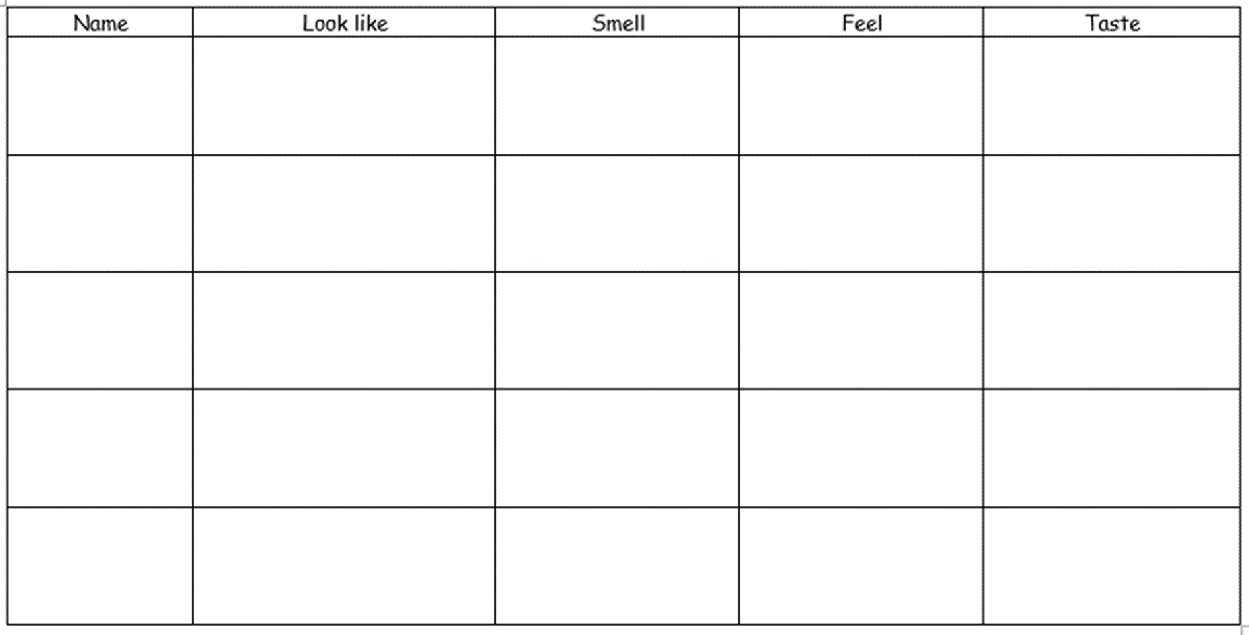
23.06.2020
WALT: use our sense to describe herbs and spices

