Slide 1
Home Schooling Made Easy:
Planning for weekly mini-topics

Slide 2
Some practical points
Some of the activities in this Powerpoint are dependent on being able to print some resources from Twinkl. Not everyone will have access to a printer. There will be lots of ways you can tweak activities or just show the information on a computer / laptop / ipad screen.
I’ve listed other practical resources needed but obviously again, not everyone has access to these resources. Perhaps that’s where friends and neighbours could safely be asked or perhaps in your online community groups.

Slide 3

Twinkl
A lot of resources we use come from Twinkl because they have such a variety of Powerpoints, work sheets and practical resources.
Twinkl are amazingly doing a months free membership:
www.twinkl.co.uk/offer
enter the code: PARENTSTWINKLHELPS

Slide 4
Home Schooling
Week 1
Daffodils

Slide 5
Activities and Resources for this week
 | Activity | Resources
Monday | Parts of a flower – dissection | Daffodils
Tuesday | Daffodil Craft Session | Coloured paper Cupcake cases Lolly Sticks
Wednesday | What does a flower need to survive? Investigation | Light coloured flower Food Colouring (gel if poss)
Thursday | Life cycle of a flower – planting | Seeds / flowers for planting
Friday | Flowers Art Session | Card frames (cereal box) Pastels (or colouring pencils)

Slide 6
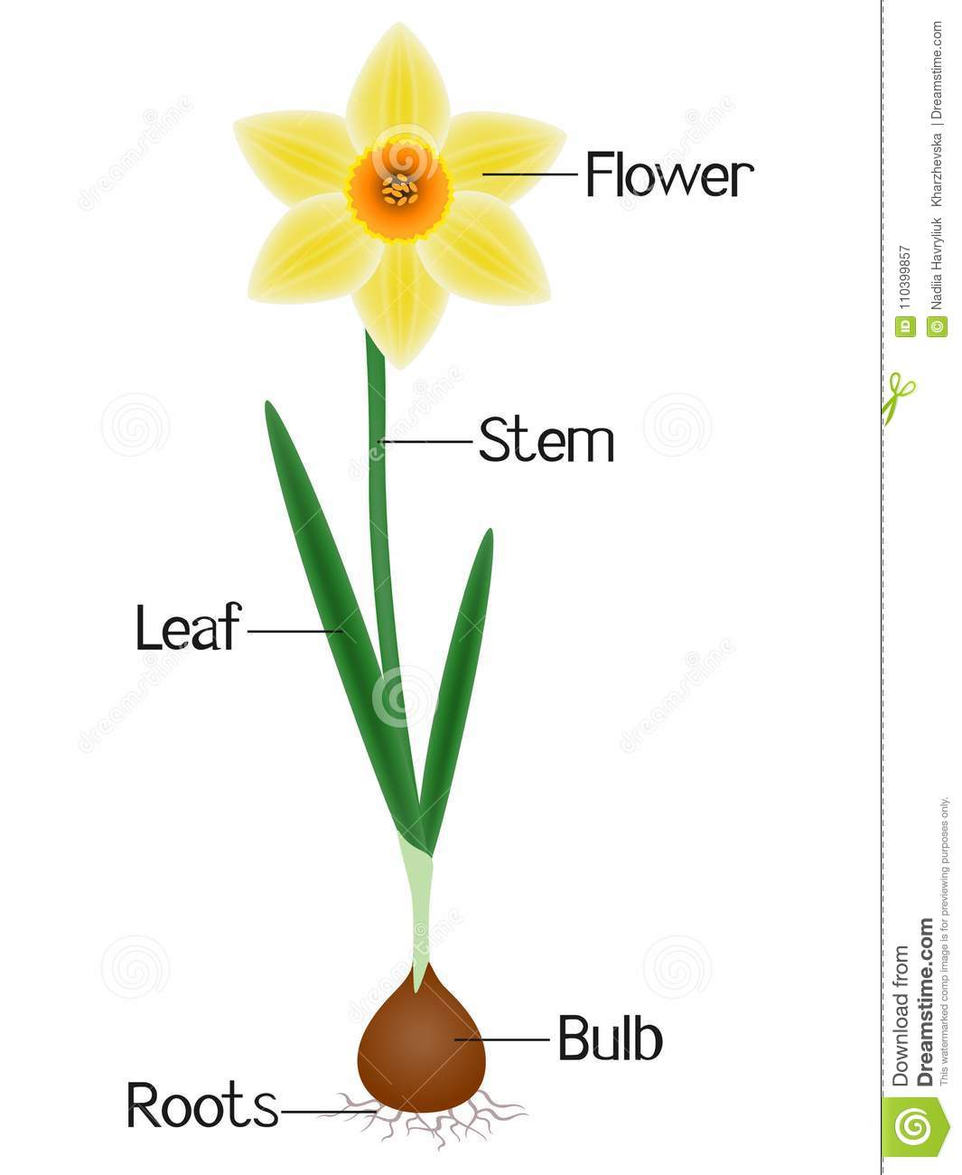
Monday
Parts of a flower

Slide 7
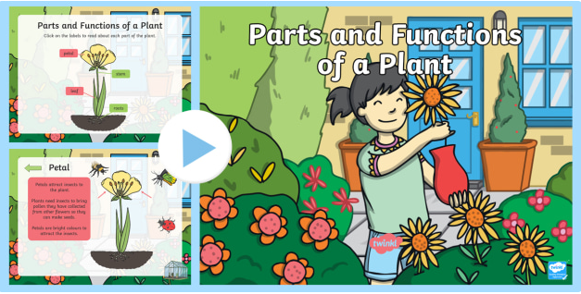
LEARN
Key Stage 1:
Look through this Powerpoint on basic ‘Parts and Functions of a Plant’ on Twinkl which can be found here.
If full web page doesn’t appear, click on the green ‘Download Now’ icon on the web page and the resource will download correctly.

Slide 8
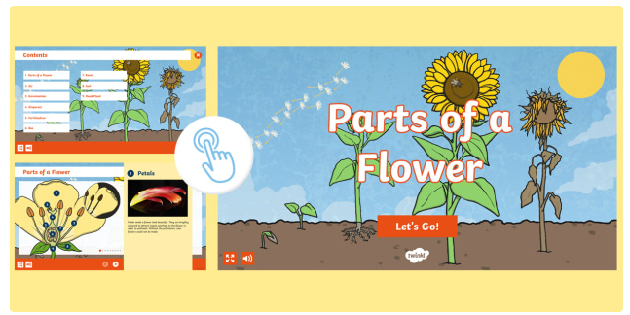
LEARN
Key Stage 2:
Look through the reproductive parts of a flower in part 1 of this ‘Interactive Plants eBook’ on Twinkl which can be found here.
If full web page doesn’t appear, click on the green ‘Launch’ icon on the web page and the resource will download correctly.

Slide 9
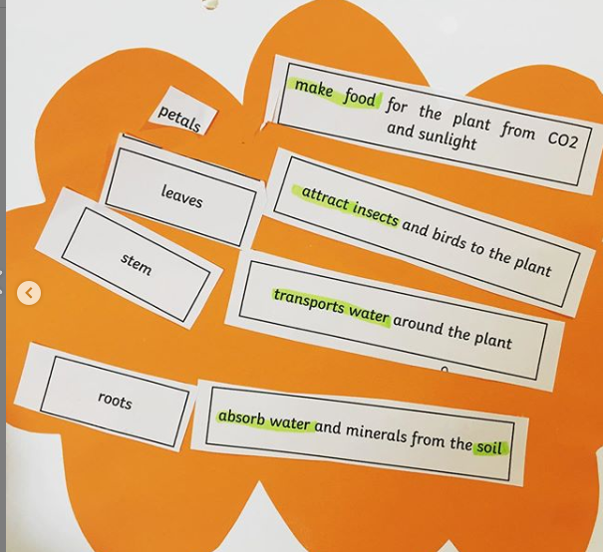
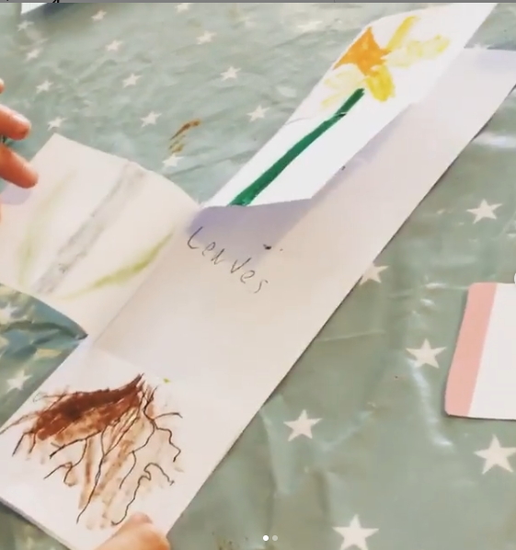
PRACTICE
Activity 1:
Key Stage 1:
Activity 1: Match vocabulary and definitions resource can be find on Twinkl here. Some children will need help with reading. They could also draw a picture to go with each definition.
Activity 2: Use this information to create a ‘foldable’ of petals, stem, leaves and roots.
Activity 2:
If full web page doesn’t appear, click on the green ‘Download Now’ icon on the web page and the resource will download correctly.

Slide 10
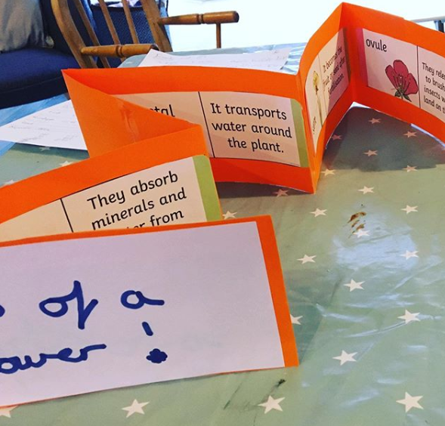
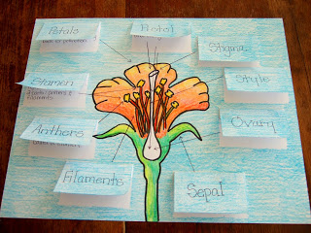
PRACTICE
Activity 1
Key Stage 2:
Activity 1:Use ‘loop cards’ from Twinkl which can be found here. Use them like dominoes to match the vocab and the definition, these can then be used to make a zig-zag book.
Activity 2: Create a visual to show the reproductive flower parts.
Activity 2
If full web page doesn’t appear, click on the green ‘Download Now’ icon on the web page and the resource will download correctly.

Slide 11
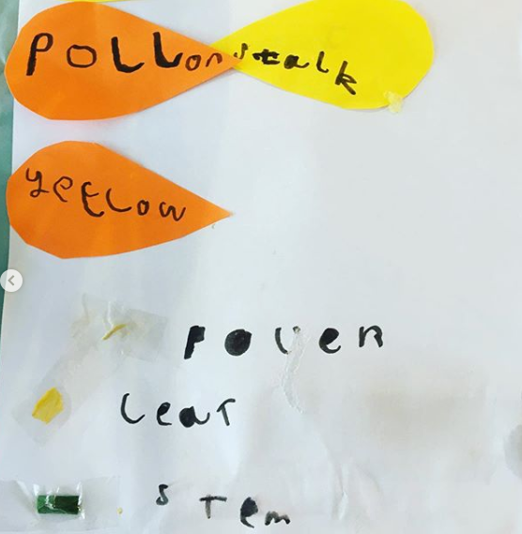
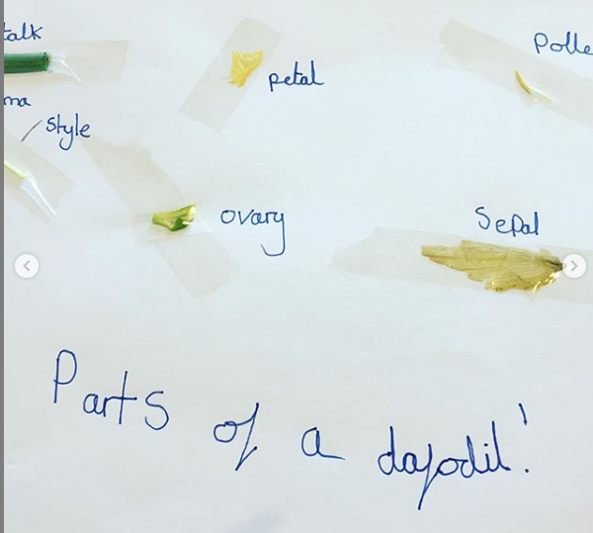
PRACTICAL
Key Stage 1
Key Stage 1&2:
Pick some daffodils and dissect them using scissors or a small knife for older children – supervise at all times. See if older children can find reproductive parts of a flower.
Key Stage 2

Slide 12
Tuesday
Craft Day

Slide 13
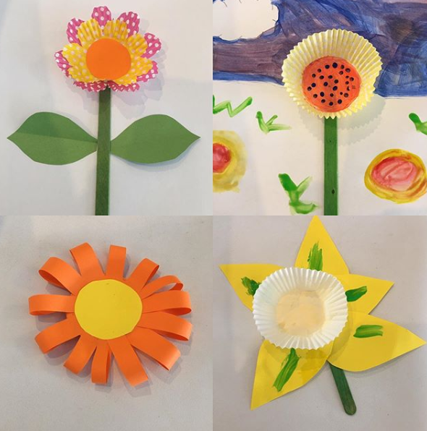
CRAFT SESSION
Lots of options for this
session – Pinterest is a great source of ideas. Show children a few examples and let them choose how to make their own daffodils and flowers.

Slide 14
Wednesday
What does a flower need to survive?

Slide 15
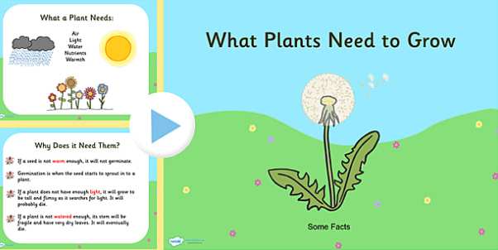
LEARN
Key Stage 1&2:
Look at the Powerpoint ‘What Plants Need to Grow’ on Twinkl which can be found here.
If full web page doesn’t appear, click on the green ‘Download Now’ icon on the web page and the resource will download correctly.

Slide 16
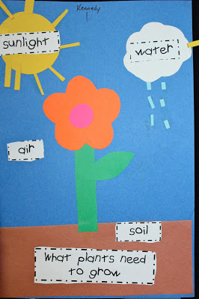
PRACTICE
Key Stage 1&2
Younger children can create the image. Older children can add an explanation to explain why the plant needs the different things to grow.

Slide 17
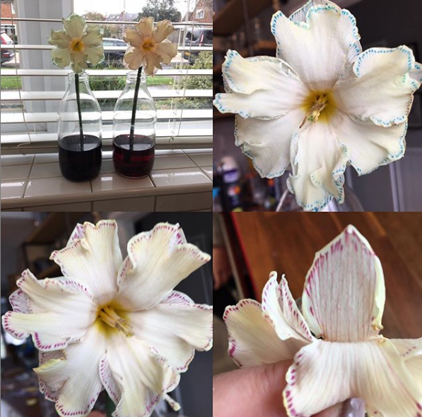
PRACTICAL
Key Stage 1&2
Put a dark food colouring into a jug/vase/jam jar with water and put a light coloured daffodil or carnation into the vase. The effect is amazing and will show how water travels through a flower. After a day or so, you can dissect to see the food colouring running up the stem of the flower.

Slide 18
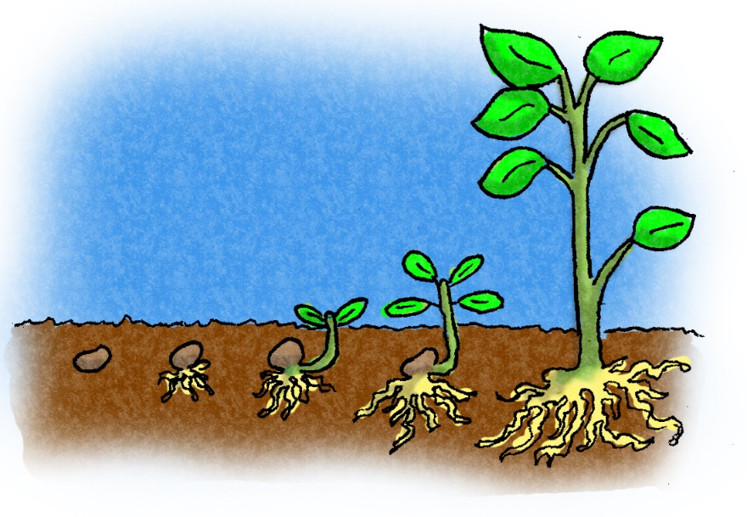
Thursday
Life Cycle of a Flower

Slide 19
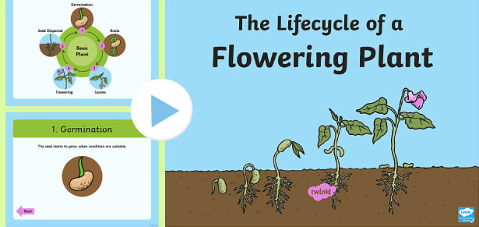
LEARN
Look together at ‘The Life Cycle of a Flowering Plant’ Twinkl Powerpoint here.
If full web page doesn’t appear, click on the green ‘Download Now’ icon on the web page and the resource will download correctly.

Slide 20
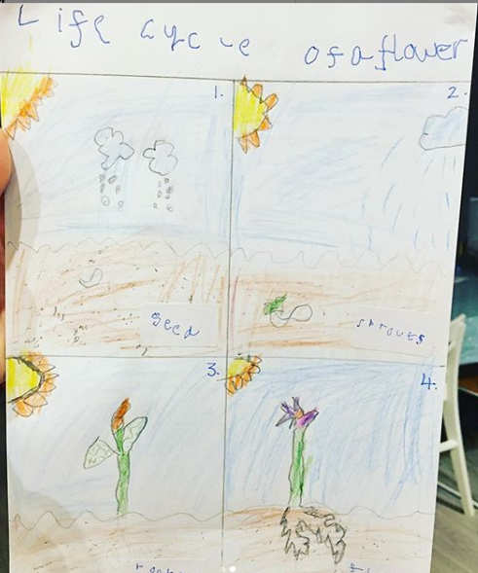
PRACTICE
Key Stage 1:
Create a visual to show 4 stages of the life cycle of a flower:
It rains on the seed
The seed shoots (germinates)
Roots and stem grow
It flowers

Slide 21
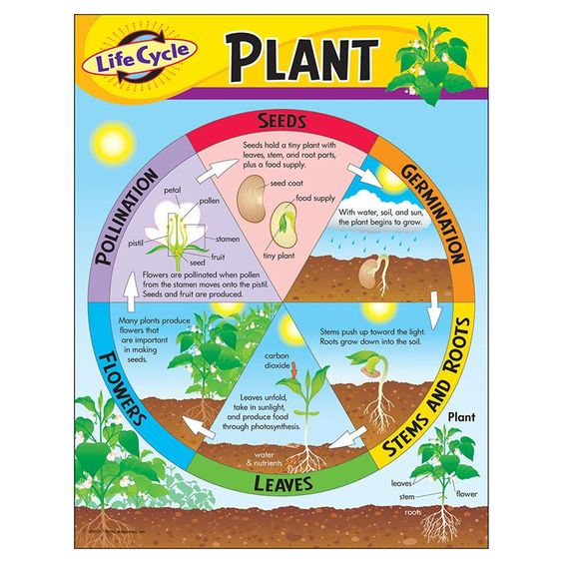
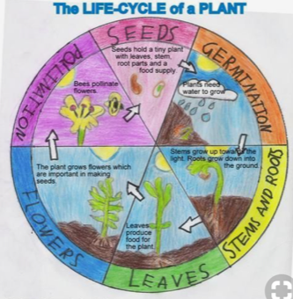
PRACTICE
Key Stage 2: Create a visual to show 5/6 stages of the life cycle of a flower

Slide 22


Slide 23
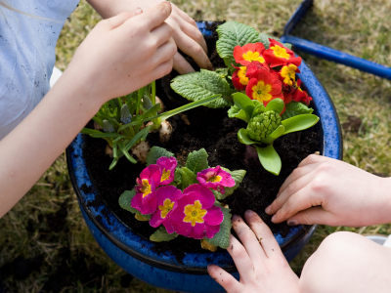
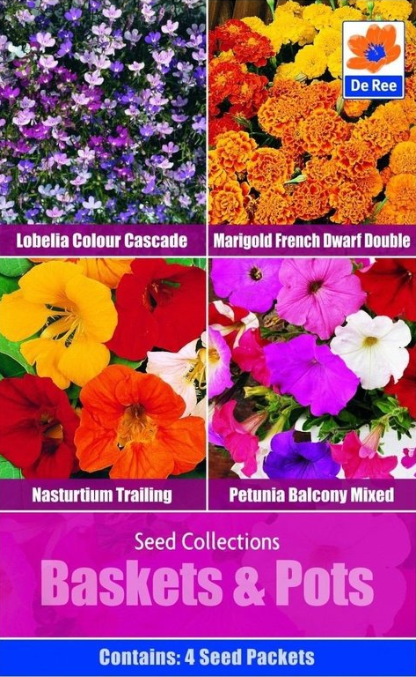
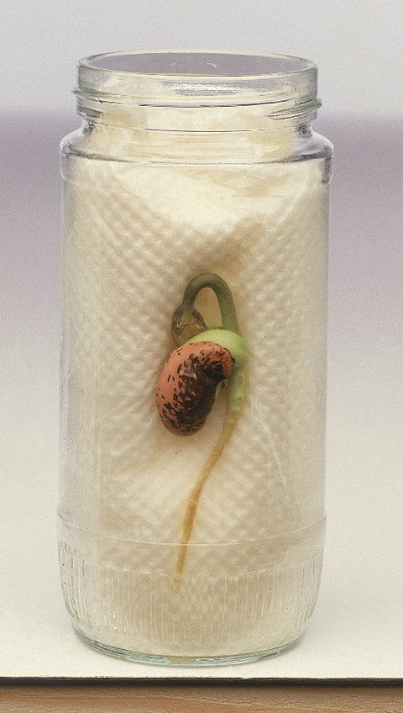
PRACTICAL
If possible, plant some seeds or flowers.
Broad beans can first be placed in a jam jar with damp kitchen roll behind them and left in a warm place. This will allow children to see the seeds at the point of germination. They can then be transferred to a pot.

Slide 24
Friday
Art Session

Slide 25
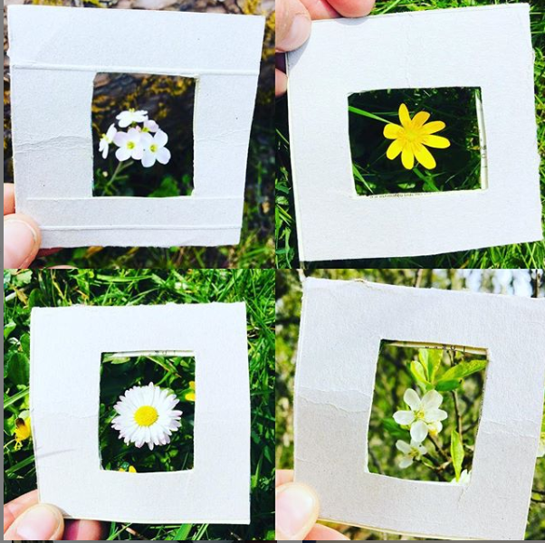
PRACTICAL
Key Stage 1&2
Cut out a small (approx. 12cmx12cm) picture frame from cardboard for each of your children - a cereal box will do.
Take an isolated walk. Chn use the card to ‘frame’ anything they see that like in nature – no right or wrong choices. Take a photo of each of their choices.
This will be used when they get home for some artwork.

Slide 26
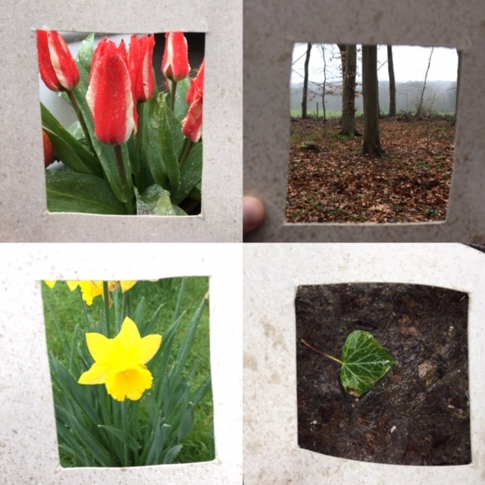
ART
Key Stage 1&2
Children choose 4 of their favourite images. Draw 4 squares on a piece of white paper (grown ups might need to do this bit). Children then use pastels (or whatever you have available) to re-create the images they have chosen. Hey presto!

Slide 27
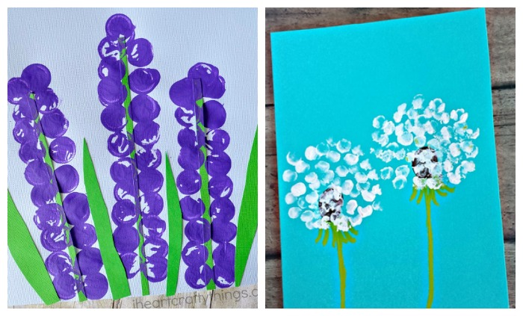
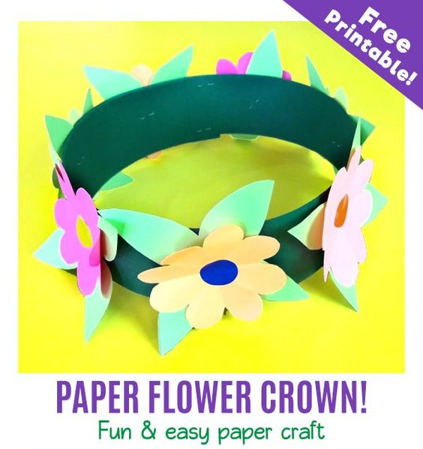
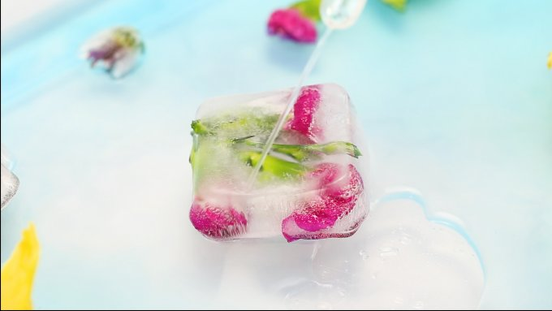
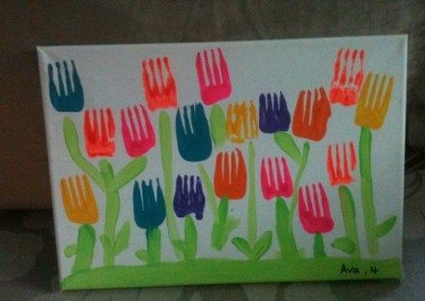
Other ideas
Build a flower resource click here.
Flower press
Visit garden centre (non Corona Virus times)
Flower identification keys
Freeze Flowers

