Slide 2
Diving into Mastery Guidance for Educators
Each activity sheet is split into three sections, diving, deeper and deepest, which are represented by the following icons:
These carefully designed activities take your children through a learning journey, initially ensuring they are fluent with the key concept being taught; then applying this to a range of reasoning and problem-solving activities.
These sheets might not necessarily be used in a linear way. Some children might begin at the ‘Deeper’ section and in fact, others may ‘dive straight in’ to the ‘Deepest’ section if they have already mastered the skill and are applying this to show their depth of understanding.
Diving
Deeper
Deepest

Slide 3
Aim
Measure and calculate the perimeter of composite rectilinear shapes in centimetres and metres.

Slide 4
Calculate Perimeter
Diving
What are the lengths of the unlabelled sides?
What is the perimeter of this shape?
?
60cm
10cm
25cm
10cm
25cm
20cm
20cm
25cm
?
10cm
25cm
10cm
60cm
300cm or 3m

Slide 5
Calculate Perimeter
Diving
This shape has a perimeter of 24cm. Can you draw a rectangle or another rectilinear shape with the same perimeter?
8cm
24cm
3cm
8cm
4cm
24cm
5cm
1cm
4cm
3cm
There are many different answers.

Slide 6
Calculate Perimeter
Deeper
Calculate the perimeter of this rectangle:
38cm
7cm
12cm
How do you know the lengths of the unlabelled sides?

Slide 7
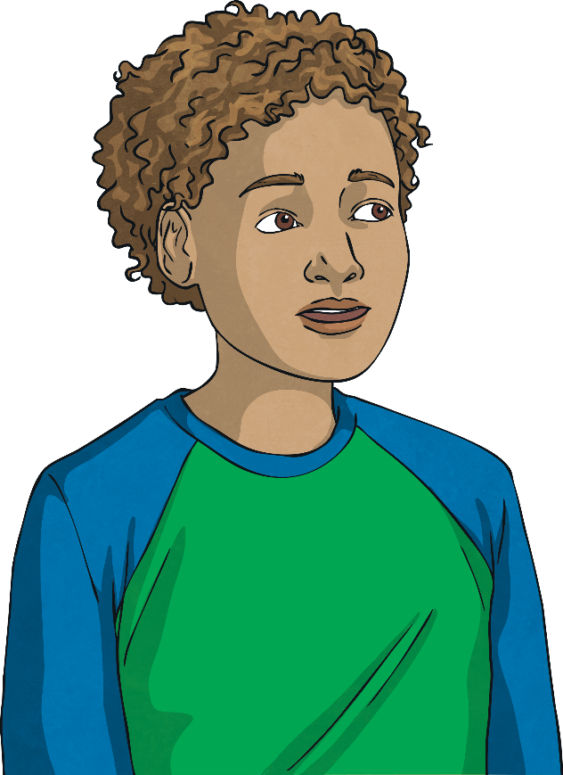
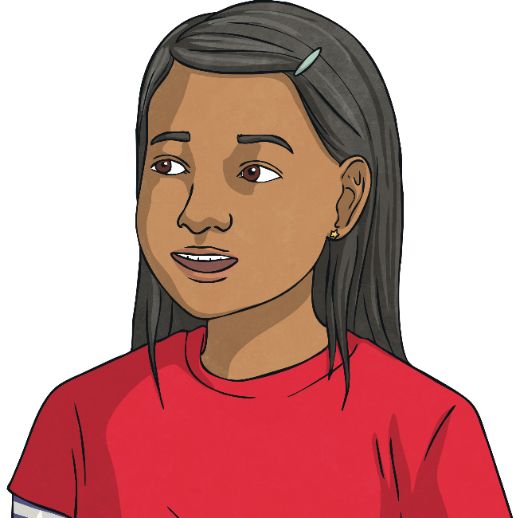
Calculate Perimeter
Deeper
Are these statements true or false? Explain how you know.
A rectangle with a base 12cm long always has a perimeter greater than a rectangle with a 3cm base.
This is false. A rectangle with a base 12cm long and a width of 1cm would have a perimeter of 26cm. A rectangle with a 3cm base and a width of 11cm would have a perimeter of 28cm, which is greater.
A rectilinear shape made from 2 rectangles side by side always has a larger perimeter than each of the rectangles separately.
This is true because the length will always increase and the width will either increase or stay the same.

Slide 8
Calculate Perimeter
Deepest
Look at these rectangles:
10m
4m
3m
3m
4m
2m
12m
12m
6m
6m
10m
2m
With a partner, discuss how you could arrange these to make 2 different rectilinear shapes.
Do your 2 new shapes have the same perimeter?

Slide 9
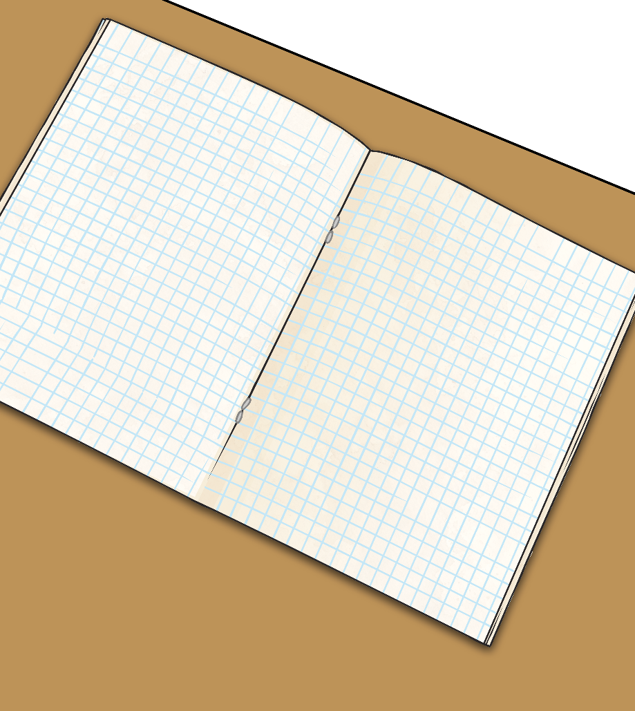
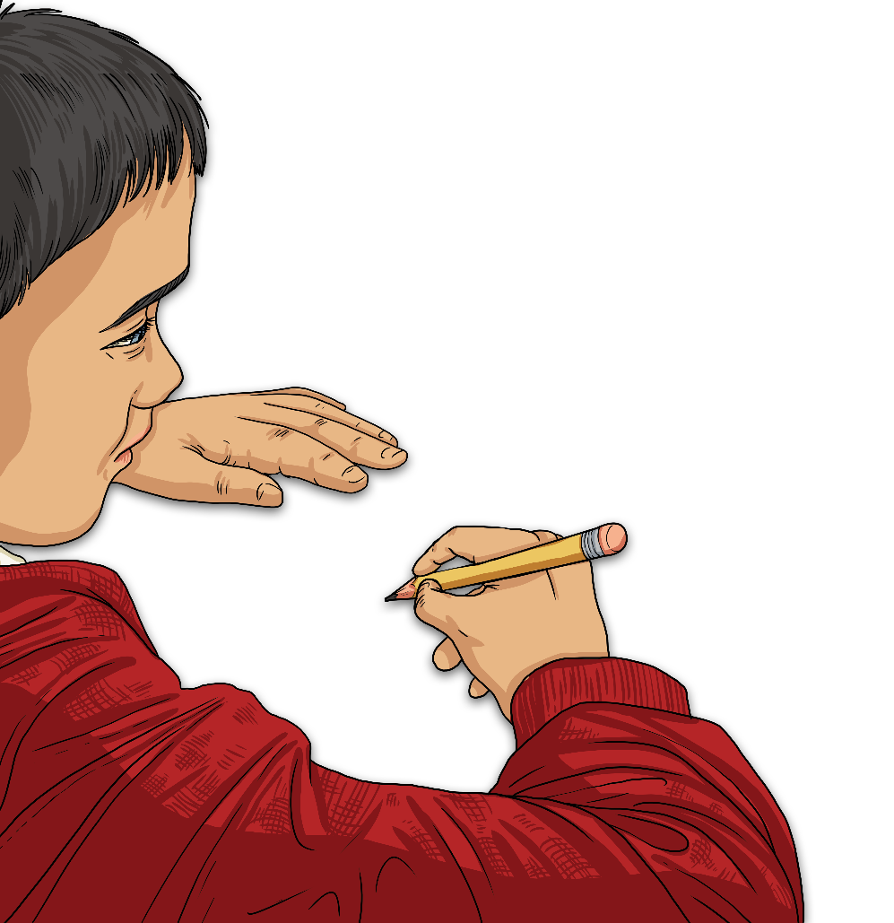
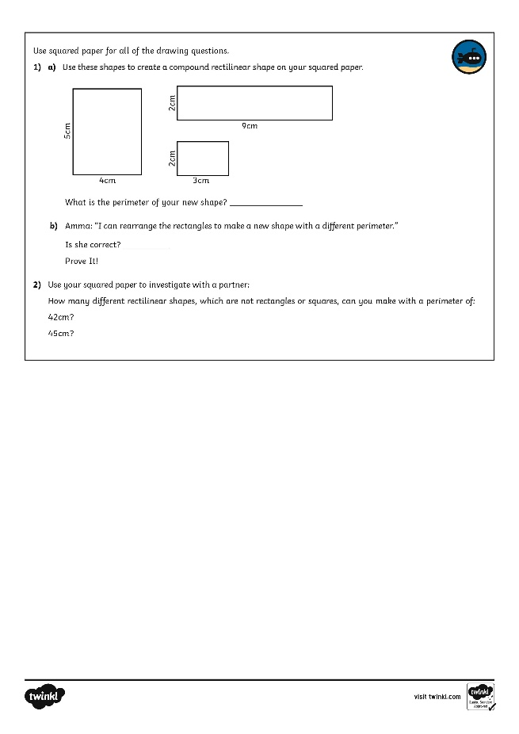
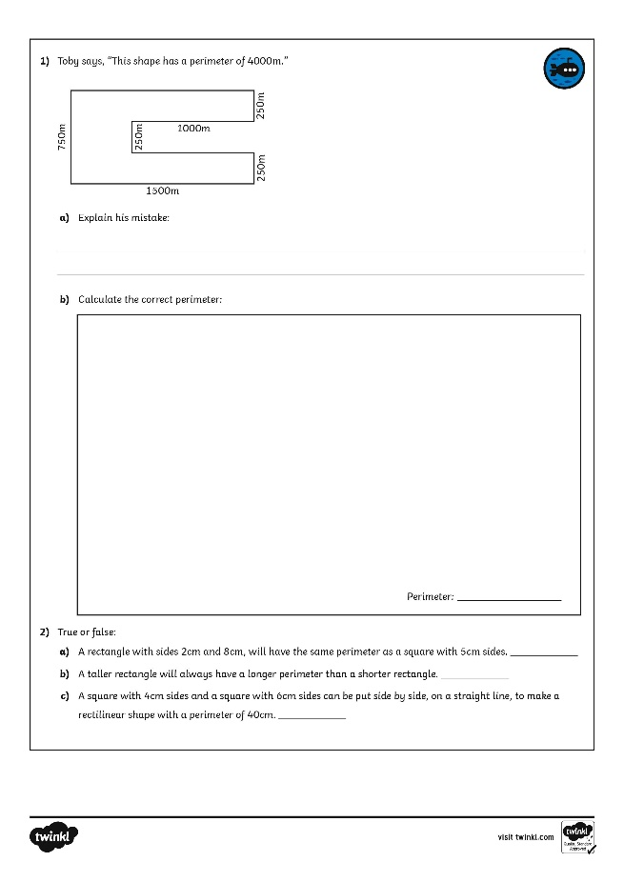
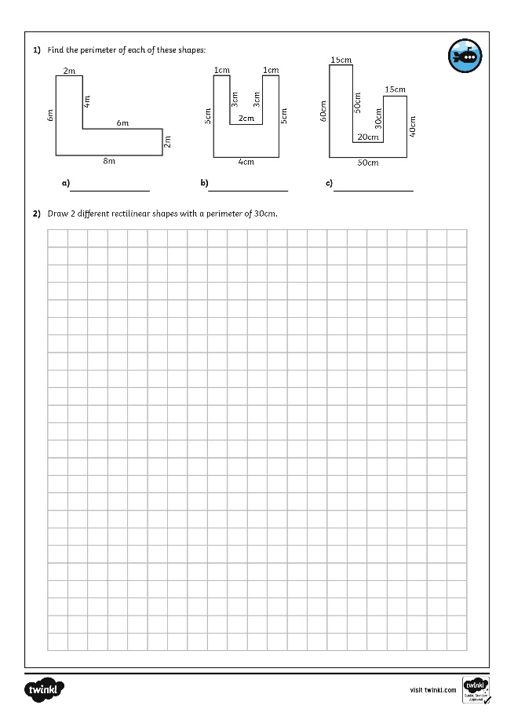
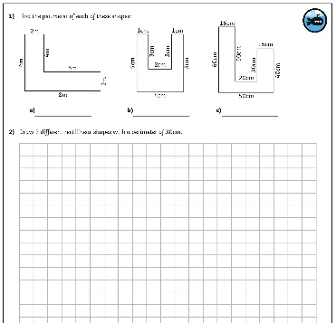
Calculate Perimeter
Dive in by completing your own activity!

Slide 10
Need Planning to Complement this Resource?
National Curriculum Aim
Measure and calculate the perimeter of composite rectilinear shapes in centimetres and metres.
For more planning resources to support this aim, click here.
Twinkl PlanIt is our award-winning scheme of work with over 4000 resources.

