Slide 1
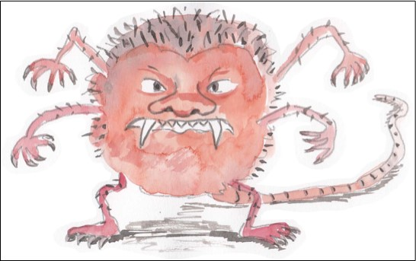

Reading and writing different forms of sentence
Questions, statements, exclamations and commands

Slide 2
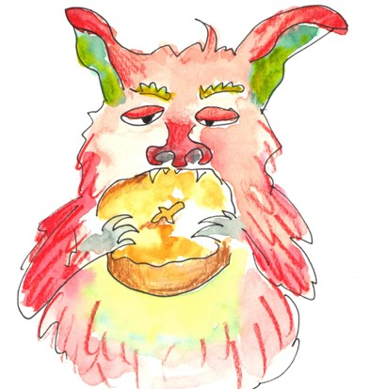
Questions
A sentence is a question when it asks the reader something.
What time is it?
Where are we going?
Do you like monsters?
Will you bring your monster to school?
Questions often begin with special ‘question words’.
where
what
when
why
which
how

Slide 3
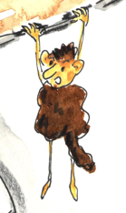
Questions
When we ask a question we use a special ‘question voice’ and our voices go up a bit at the end of the sentence.
Try reading these questions out loud:
Did you see a monster at my house?
Is it a dangerous monster?
How long has it been there?
All questions end with a question mark. ?

Slide 4
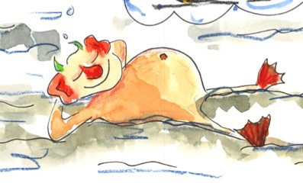
Statements
A sentence is a statement when it simply gives the reader some information.
Statements end with a full stop.
My name is Sunitha.
I think a monster has chosen to visit me.
The monster lies in the sun.

Slide 5
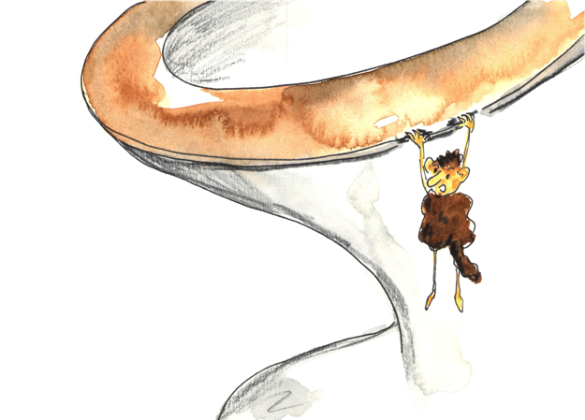
Questions and Statements
Read these sentences. For each one, say whether it is a question or a statement.
The monster is hanging around.
Why’s he doing that?
Will he hurt me?
No, he only eats soap, I think.
Statement
Question
Question
Statement

Slide 6
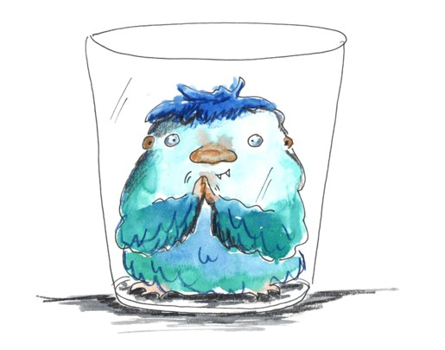
Exclamations
Exclamations or exclamatory statements are a special kinds of sentence that are said with extra feeling and force.
How
They often begin with these words:
What
Or make use of phrases like…
such a…
just so…
What a scary monster!
How frightening!
Exclamations end with !
It has such big teeth!
Just fancy it being here!

Slide 7
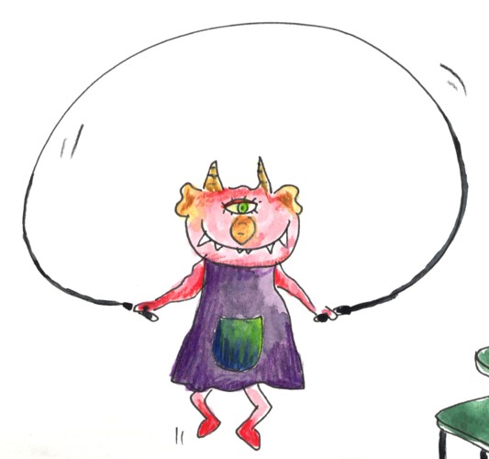
Commands
A sentence is a command when it is bossy and gives an order or an instruction.
Commands begin with bossy verbs.
Come over here now.
Ignore the monster.
Stop skipping indoors.
Don’t shout!
Commands mostly end with a full stop.
Occasionally they end with !

Slide 8
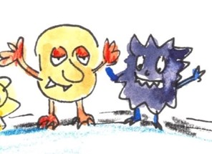
Exclamations and Commands
Read these sentences out loud. Say whether they are exclamations or commands. Don’t forget to use the right kind of voice!
Sit still and stop wriggling!
What a terrifying monster!
How scared I was!
Make it go away.
Command
Exclamation
Exclamation
Command

Slide 9

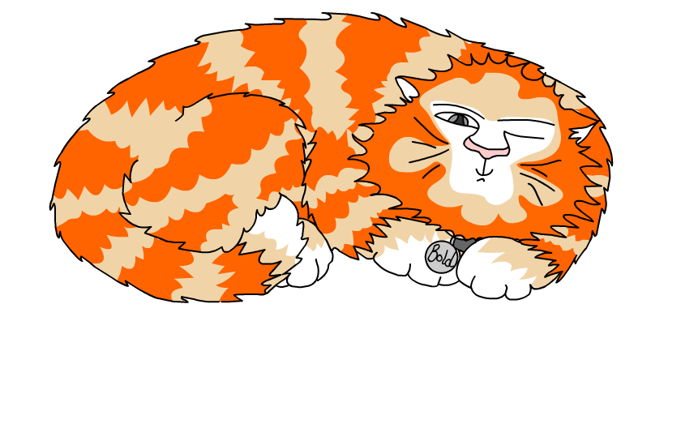
Explore more Hamilton Trust Learning Materials at https://wrht.org.uk/hamilton/ .

