Slide 2
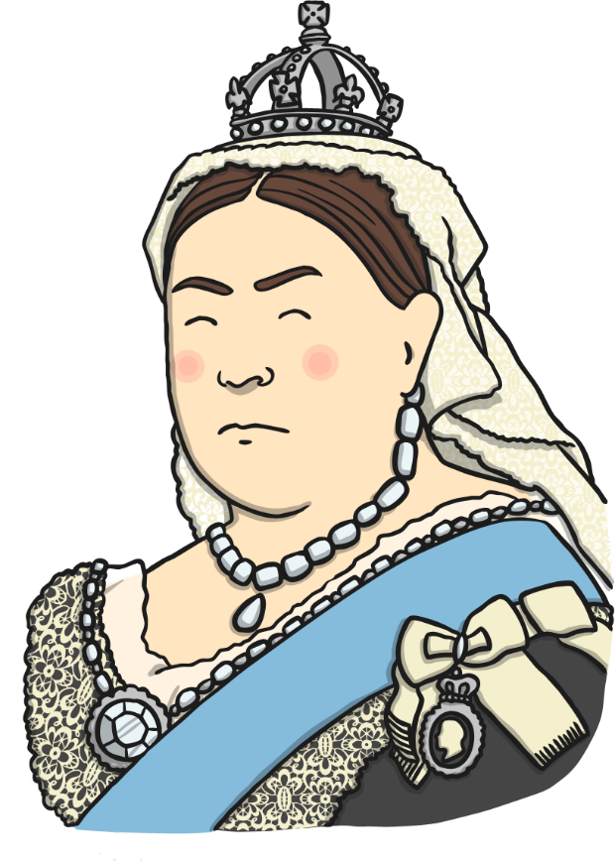
The Victorians
The Victorians were people who lived in the United Kingdom a long time ago.
They got their name because the Queen at that time was called Victoria.
Talk
About It
Do you know what the current
Queen is called??
Queen Victoria became Queen in 1837 and reigned
for over 60 years until 1901.

Slide 3
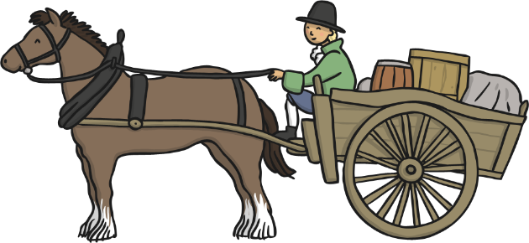
Victorian Times
Life in Victorian times was very different from now.
Although cars were invented during the Victorian times, there were only a few of them and they were very expensive. Most people walked or rode in horse-drawn carriages.

Slide 4
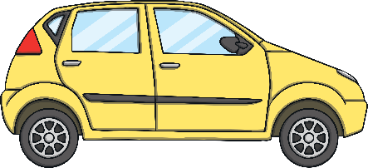
Victorian Times
For a lot of the Victorian era, only rich children went to school. Poor children often had jobs from a very young age, even your age!
Talk
About It
If you had a job, what would it
be and why?
Today, we are going to compare modern houses with Victorian ones.

Slide 5
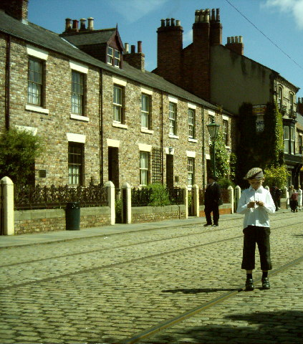
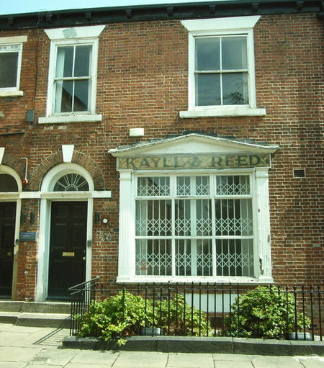
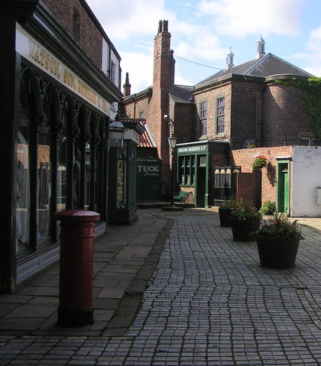
Victorian Houses
Victorian houses were heated with fires, so Victorian houses had chimneys. They didn’t have garages because there weren’t any cars. The very first car wasn’t built until towards the end of Victorian times. It would be many years before ordinary people drove them on roads.

Slide 6
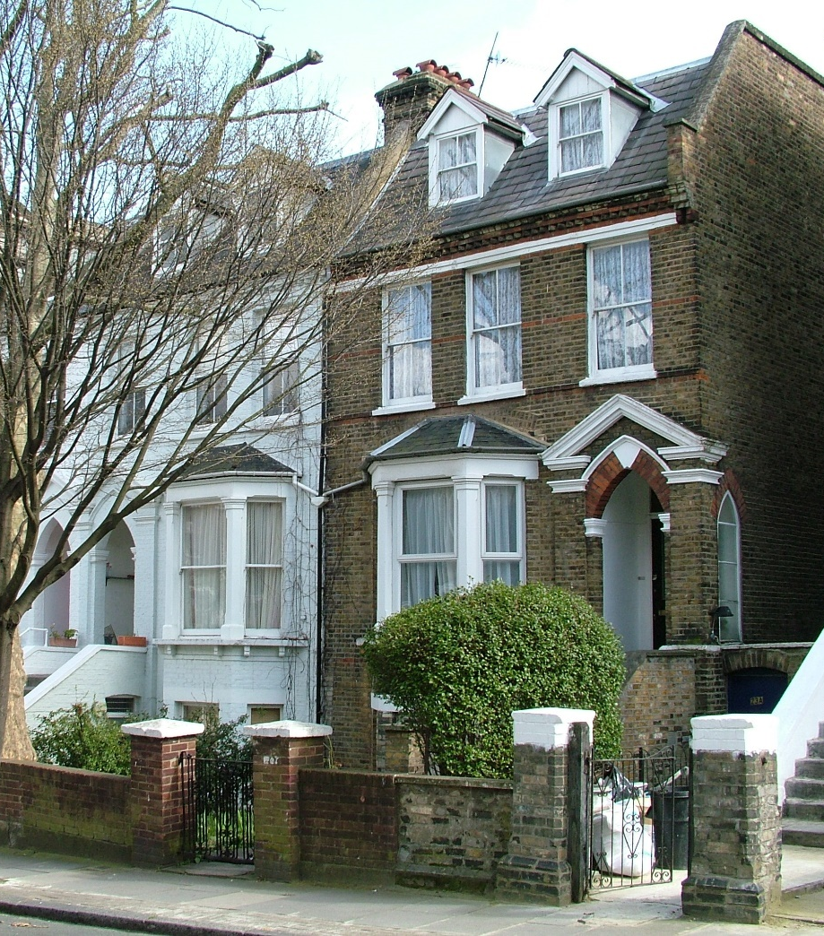
Victorian Houses
The roads could be quite narrow because they were made before cars; you may have driven down a road of Victorian houses and noticed that there isn’t much space for cars to pass the parked vehicles.

Slide 7
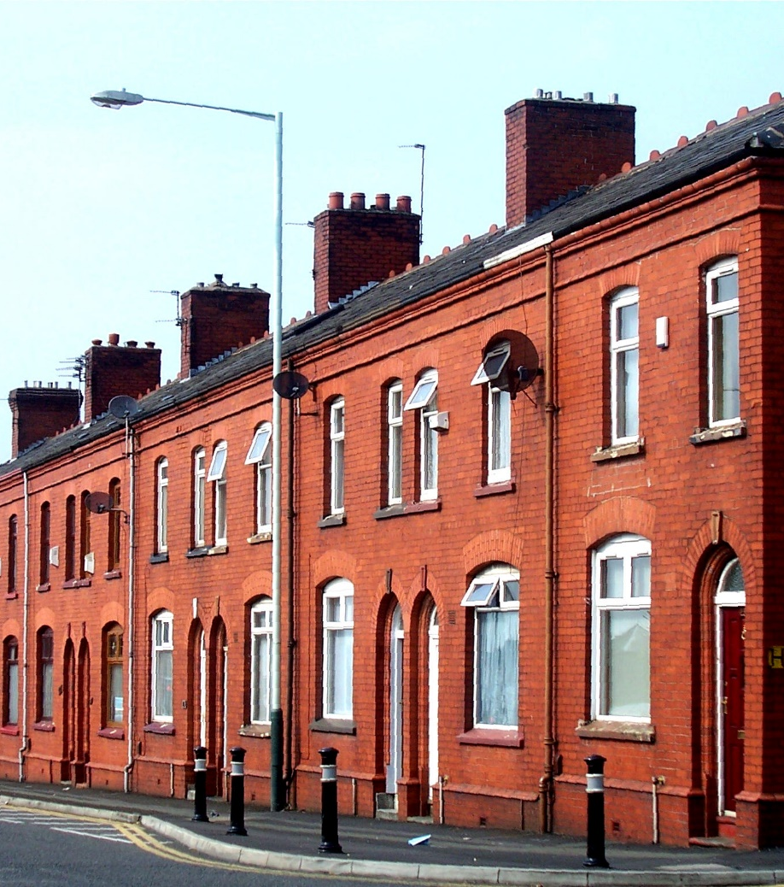
Victorian Houses
Because so many people moved to towns and cities to work in factories, lots of new houses were needed during Victorian times. Rows and rows of back-to-back terraced houses were built. These houses were very small, with two rooms downstairs and two rooms upstairs. They didn’t usually have gardens, but small yards.

Slide 8
Victorian Houses
Richer Victorians lived in houses much bigger houses. They had lots of rooms, sometimes even having rooms in the attic for servants to sleep in.

Slide 9

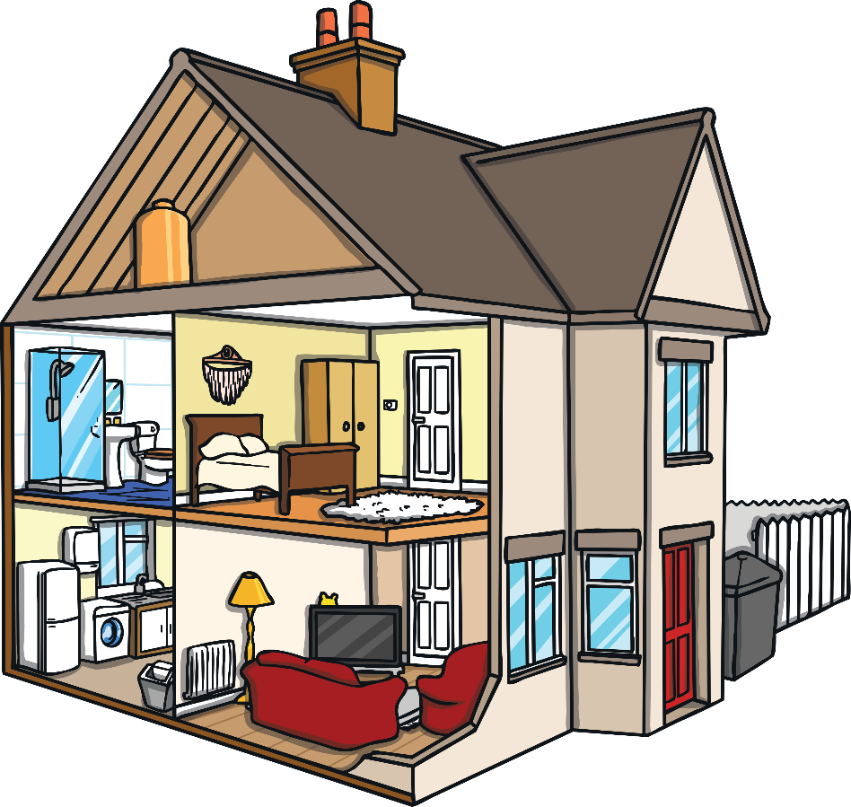
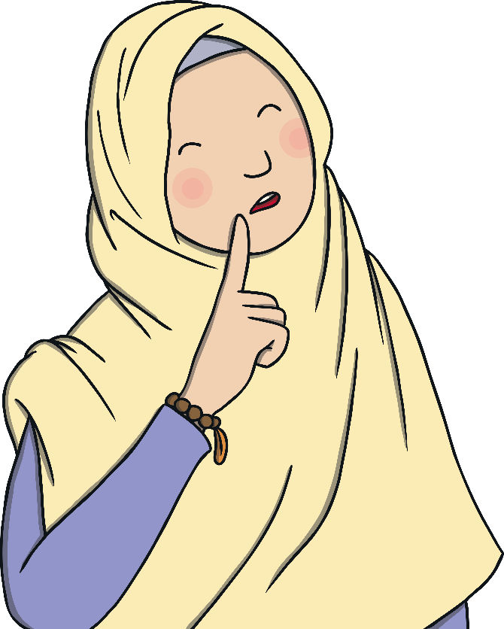
Comparing Houses
Click on the room to find out how modern houses are different to Victorian ones.
2
4
1
3

Slide 10
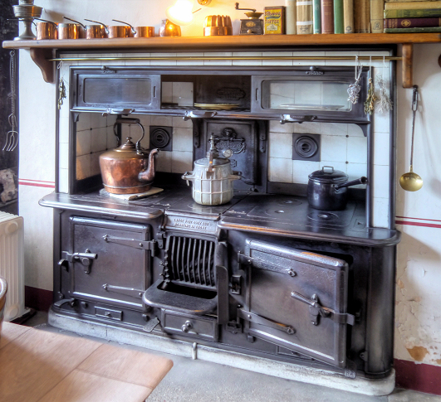
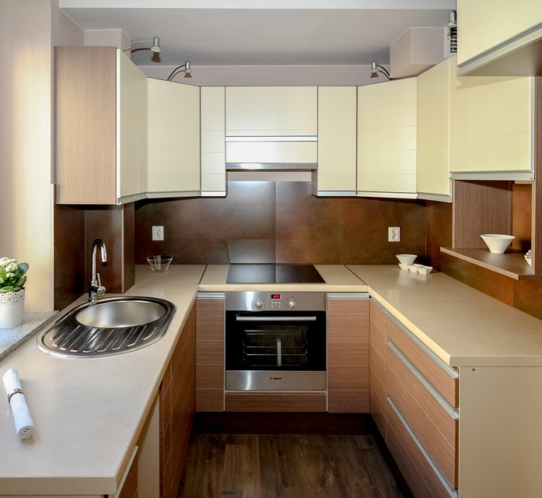
Kitchen
The Victorians (or their servants if they were rich) cooked on a range. This is also how water was heated, as there wasn’t hot water from a tap in Victorian homes. A range was powered by coal.
Victorian Aga by Samuel Johnson is licensed under CC BY 2.0
back

Slide 11
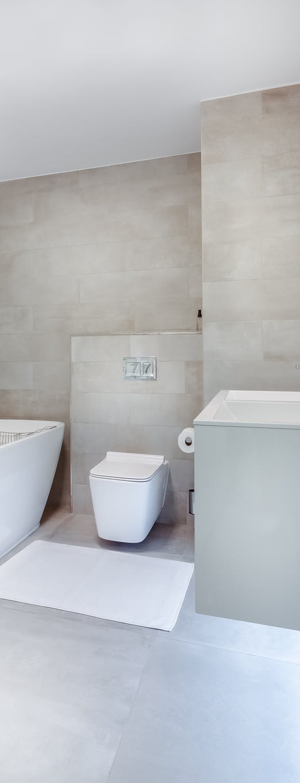
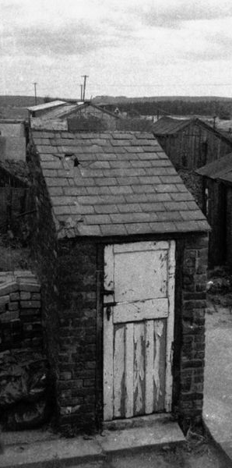
Bathroom
Many Victorian homes didn’t have a bathroom. The toilet would have been outside like the one shown. Poorer people had to share toilets with other houses. Most poorer families would have bath night once a week. Water would be heated on the range and put in a tin bath in front of the range in the kitchen.
Toilet Outdoor by Joanna Illingworth is licensed under CC BY 2.0
back

Slide 12
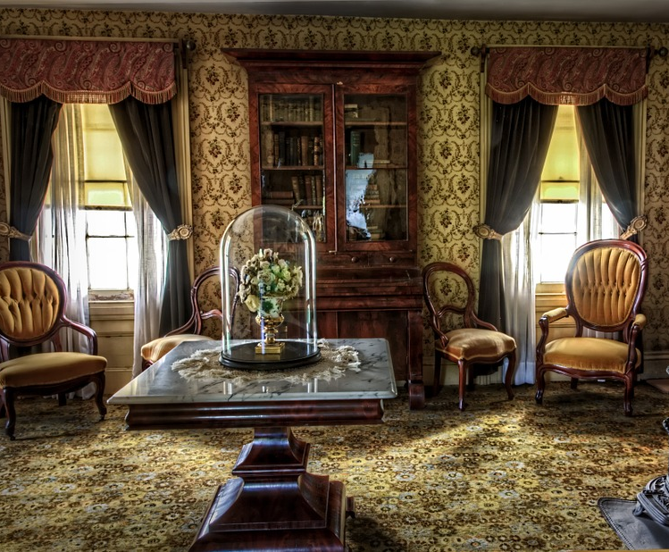
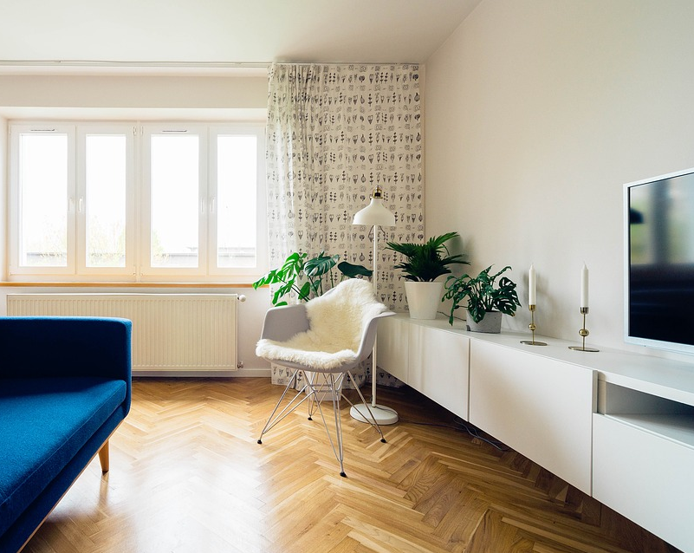
Living Room
For most of the Victorian times, houses didn’t have electricity. A few houses had some electricity towards the end of Victorian times, but this was very unusual and only for the richest. Candles were a main way of lighting houses, as were lamps that used paraffin or gas.
back
Victorian Living Room by Peter Wright is licensed under CC BY 2.0

Slide 13
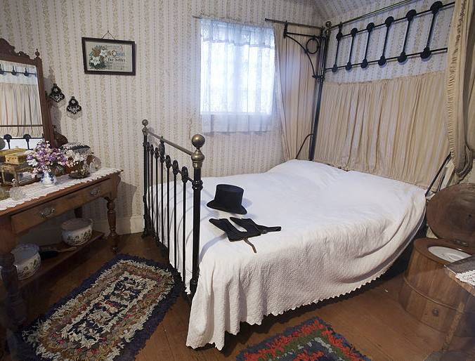
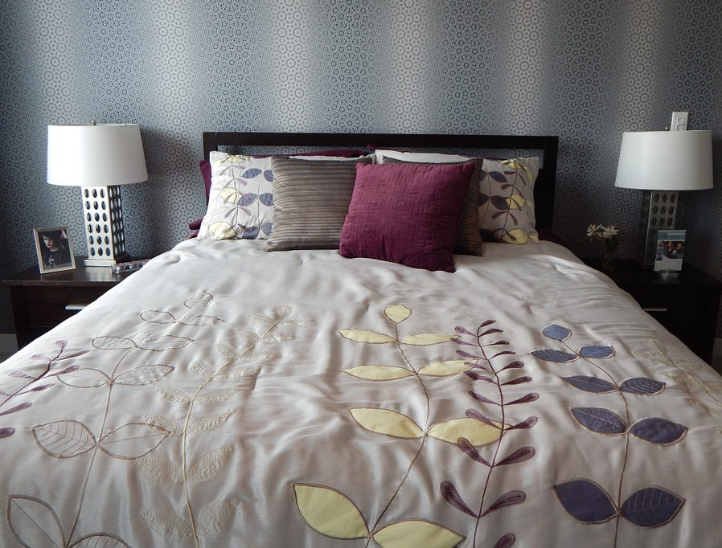
Bedroom
Duvets weren’t used in Victorian times, beds were covered in lots of blankets.
There was no central heating so lots of blankets were important. You can see in the picture of the Victorian bedroom that there are rugs on the floor instead of a carpet. These are called rag rugs and they were made from left-over scraps of material.
Victorian bedroom by john down is licensed under CC BY 2.0
back

