Slide 2
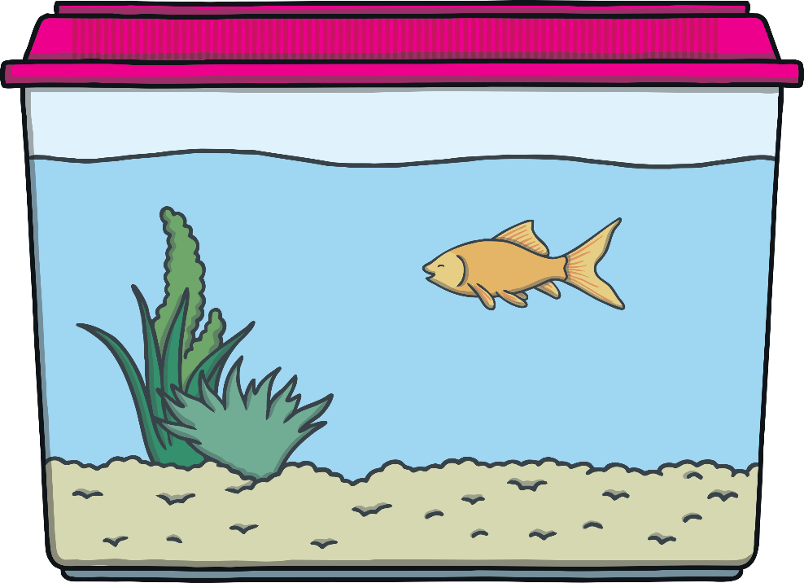
Are You Ready?
There are 5 questions in this quiz.
They are all to do with measuring capacity.
Each question is multiple choice.

Slide 3
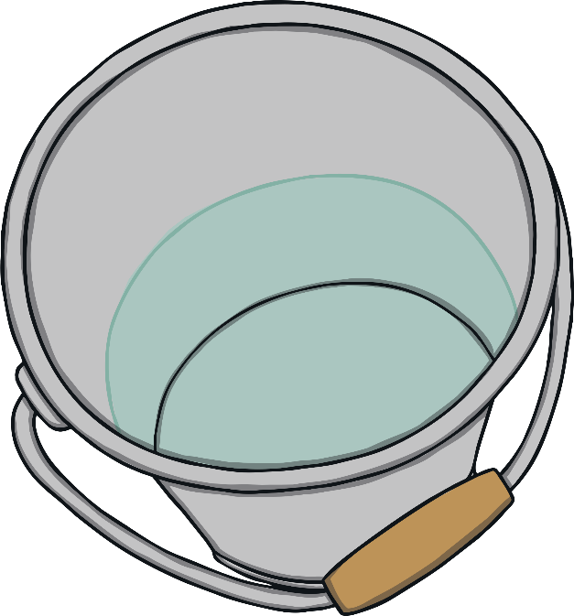
Question 1
It takes 10 cups of water to fill this bucket.
How many cups will it take for the bucket to be half full?
4 cups
7 cups
5 cups
9 cups
Half of 10 is 5. So to fill half the bucket, you need 5 cups of water.

Slide 4
Question 2
How full is this bottle?
full
nearly full
half full
nearly empty
The water is half way up the bottle.

Slide 5
Question 3
Which bottle is nearly full?
a
b
c
d
Bottle b is nearly full.

Slide 6
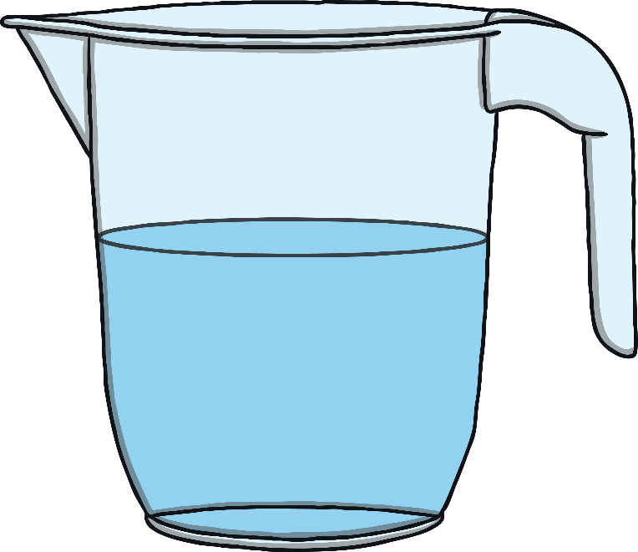
Question 4
This jug contains 4 litres of water when it is full.
Estimate how much water is in the jug.
1 litre
2 litres
3 litres
4 litres
The jug is approximately half full. Half of 4 is 2.

Slide 7
Question 5
This fish tank contains 11 litres when it is half full.
How much does it contain when it is full?
20 litres
21 litres
22 litres
24 litres
2 × 11 = 22 so the fish tank contains 22 litres when it is full.

