Slide 1
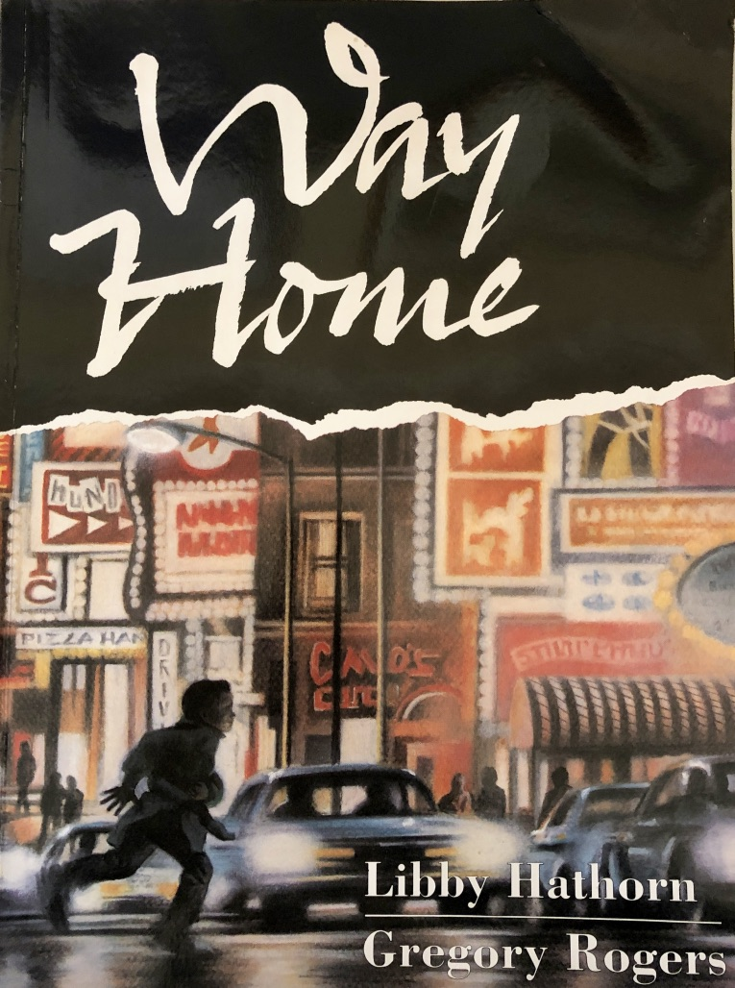
Formal and Informal Language
What is formal and informal register and when do we use it?
How do contractions, question tags, slang and ellipsis affect the register of our language?

Slide 2
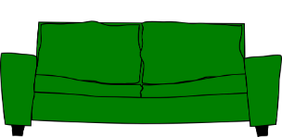
Audience and Context
The register depends on situation and audience.
The same person will use different registers in different contexts.
At home with family
In school with the headteacher
In formal writing
You’re going to wear that, are you?
When will we be going on the museum trip?
I wonder, might I be permitted to enquire about progress?
Informal
More Formal
Very Formal

Slide 3
Register
Formal language is often used for:
Situation | Audience
Official or formal situations | People you don’t know
Generalised or impersonal writing | People in official/important roles
Written communication more than spoken | People as a group
We would like to request your presence at a dinner in aid of our charity.
We regret to inform you that your attendance at the school will be terminated at the end of term.
Please remain in the shelter after dark.
Cats have been domesticated for thousands of years.

Slide 4
Register
Informal language is often used for:
Situation | Audience
Everyday conversation | Family, friends and people you know well
Social media and texts | People similar to you
Most spoken communication | People you meet in day-to-day life
It’s okay, man. Thanks for trying.
Eeew! That’s disgusting - that is.
I’m outta here. Coming?

Slide 5
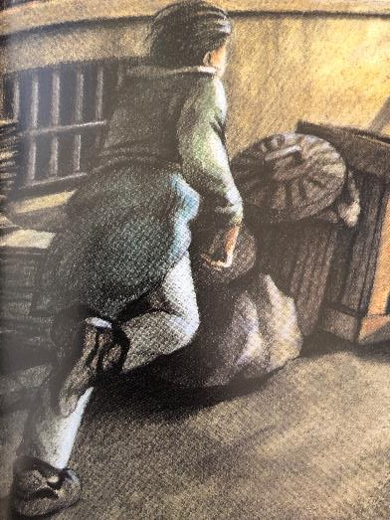
Formal and Informal Vocabulary
Formal and informal registers tend to use different vocabulary.
Could you assist me?
Can you help me?
It is time to flee.
It is time to leg it.
Who is the champion?
Who’s the champ?
He was pursued by the youths.
He was chased by big kids.
Informal
Formal
With formal vocabulary, words are often longer.

Slide 6
I’d
what’s
we’re
you’re
Contractions
Contractions appear in informal language.
mustn't
haven’t
Spoken language often contains contractions…
but written formal language uses the longer versions of the word/s.
We might write:
Do not say that I did not warn you.
but we are more likely to say:
Don’t say I didn’t warn you.
What are the formal versions of the contractions above?

Slide 7
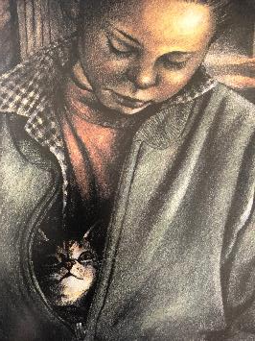
Question Tags can be used in informal language.
Tags are questions added to a clause to encourage a listener to respond.
Tags can be used to soften a command.
main clause
Tag
The tag changes a statement into a question.
main clause
Tag
We’re mates
, aren’t we?
You’re joking
, aren’t you?
In very informal speech right and yeah can be used as tags.
main clause
Tag
main clause
Tag
Look at that Fatcat
, will you?
You’re ready
, yeah?

Slide 8
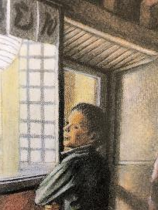
Breaking Grammar Rules!
Informal language sometimes breaks grammar rules.
This is effective when used sparingly for writing realistic dialogue...
(or in text messages and on social media).
You and me in a Jag. Vroom vroom.
I am imagining how fun it would be to drive in a Jaguar together. Can you imagine the noise that the engine might make?
See they cook stuff right on the table in front of you.
Look through this window with me. You will see how the food is cooked at the diner’s table.

Slide 9
Breaking Grammar Rules!
Ellipsis (omitting words) has not changed the meaning but the grammar is now incorrect. This is common in informal spoken language.
Nobody lives in them – no way.
Nobody lives in them; there is no way that they are occupied.
Slang can be used to write realistic dialogue.
Slang can help to make the speech sound authentic.
Whaddo you reckon?
What do you think about that?

Slide 10
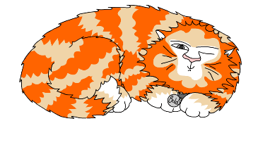
Explore more Hamilton Trust Learning Materials at https://wrht.org.uk/hamilton/ .

