Slide 1
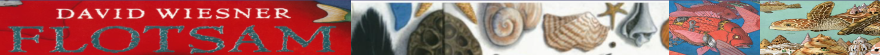
Tuesday 23.6.20​
WALT:- Writing to Entertain – Descriptions Creating Metaphors and Similes.​
TASK- ​
Today we are going to write Metaphors and Similes to help us to describe our chosen scene from David Wiesner’s book – Flotsam.​
​
Metaphors and Similes are ways to describe something by comparing or likening something to something else.​
​
A Simile is when we say something is like something else and a Metaphor is when we say something actually is something that it is not. For Example:- ​
​
From The Adventures of Huckleberry Finn by Mark Twain ​
“He was most fifty, and he looked it. His hair was long and tangled and greasy, and hung down, and you could see his eyes shining through like he was behind vines. It was all black, no gray; so was his long, mixed up whiskers. There warn’t no colour in his face, where his face showed; it was white; not like another man’s white, but a white to make a body sick, a white to make a body’s flesh crawl – a tree-toad white, a fishbelly white.”​
​
Here the Author uses a Simile “Like he was behind Vines” to describe how his eyes look out from behind his hair hanging down –like vines. He also uses two Metaphors – “A tree-toad white, a fishbelly white” to describe his skin colour.​

Slide 2
Tuesday 2.6.20​
WALT:- Writing to Entertain – Descriptions Creating Metaphors and Similes.​
TASK - ​
The Author – Mark Twain – deliberately chooses unpleasant things to compare the character’s description to – this is because he wants the reader to make associations from their thoughts and feelings about those unpleasant things and apply them to their thoughts about the character. It is deliberate. The author is using Metaphors and similes to make the reader feel negative about the character.​
We are going to do a similar thing today when we create some metaphors and similes to describe our chosen under water scene from Flotsam.​
1). Decide how you want your reader to feel about this scene – is it happy and friendly and positive, or is it sad or scary and negative? ​
2). When you have decided, use the Metaphor and Simile maker to come up with some Metaphors and Similes for your scene.​
3). You can add more if you want to and even combine metaphors and similes into one sentence if you want.​
*Remember – you do not need to print out the metaphor/simile makers, you can just copy them onto paper.​

Slide 3
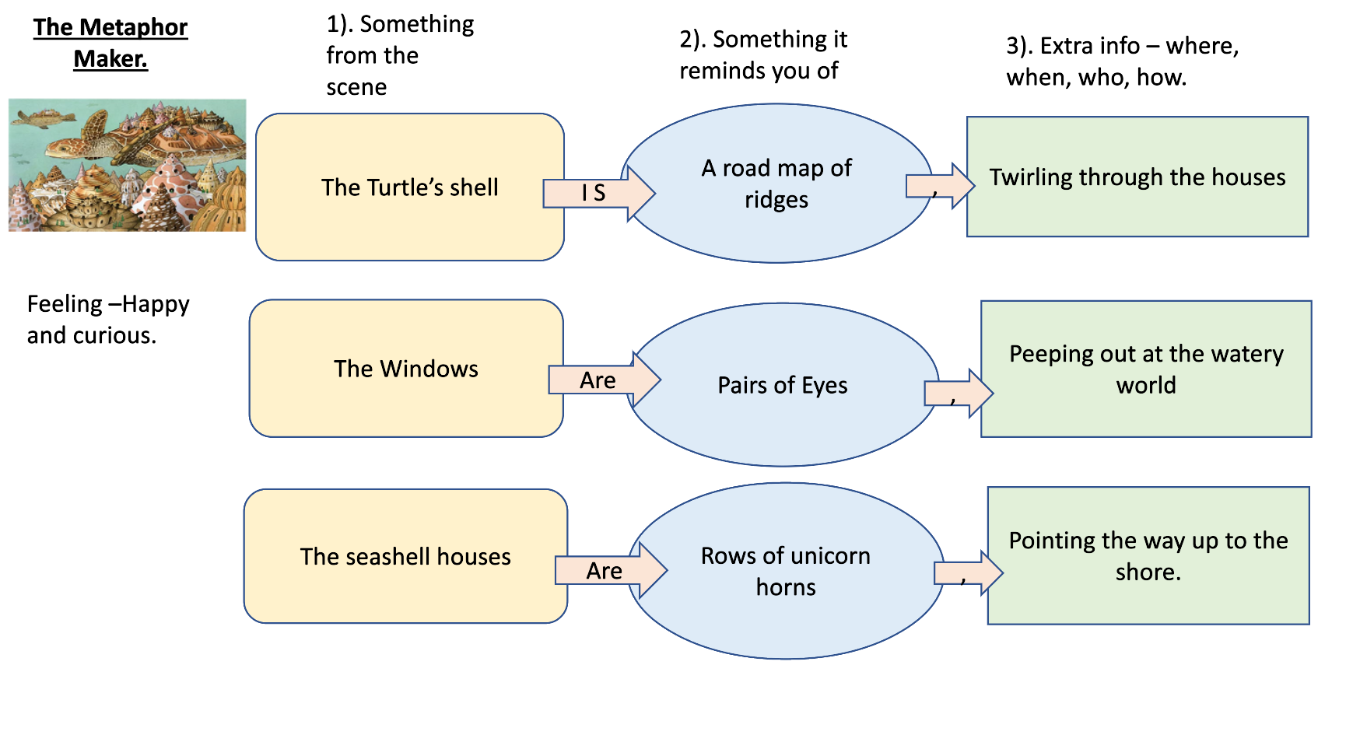

Slide 4
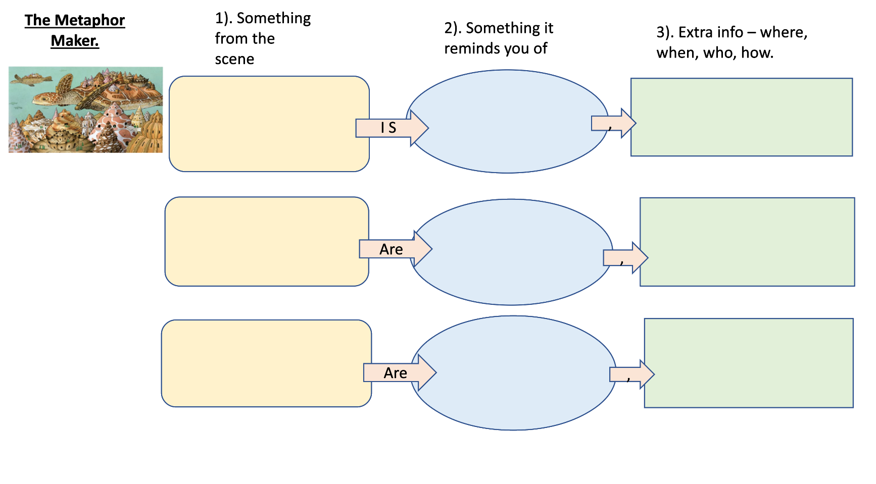

Slide 5
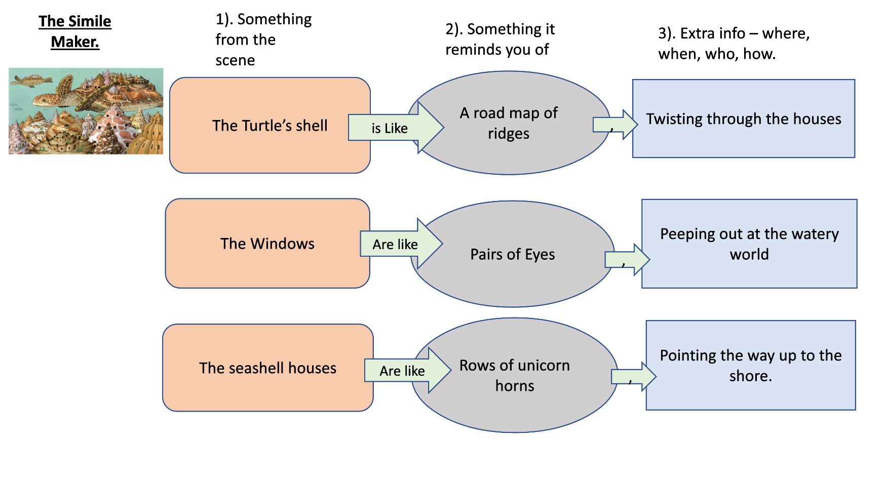

Slide 6
