Slide 1
WALT:- Writing to Entertain – Descriptions.​ ​ Over the next few weeks we are going to be looking at the wordless book by David Wiesner called Flotsam. Flotsam is a word that describes the many and varied objects and life that get moved around the world’s seas by the many oceans and currents and often gets washed up on beaches. ​ This book is a series of wonderful, detailed illustrations that need plenty of time to look at- again and again – to see the wonderful and detailed world that David Wisner has created. Take your time to look through each page of the Book to see what you can notice. What is the story of the Boy and the camera? What is the secondary story of underwater imaginary worlds?​ ​ We are going to use these wonderful images and story ideas to help us to write over the next few weeks. We are going to be writing to Entertain.​ ​ We are going to begin this week with writing a description.​

Slide 2
Monday 22.6.20​
WALT:- Writing to Entertain – Descriptions:- Imagery and ideas.​
TASK- Today we are going to begin to build up the impactful vocabulary needed for a successful description. Begin by looking at Davis Wiesner’s images of imaginary underwater worlds and scenes. Choose the one that interests you most. Take some time to look at it carefully and notice all the detail. ​
We are now going to use the idea bubbles to help us to create some impactful vocabulary and phrases to describe the scene. (Please remember you DO NOT have to print them – just copy them on paper).​
Look at the image and use it to generate some descriptive words and sentences that you might use later. ​
​
1).Firstly fill in all the blue squares with what comes into your mind about the scene. Choose 3 things you can see, one you can hear, one you can smell, one you could touch and one that sparks a memory of something else.​
​
2). Now fill the yellow circles with another idea – related to the square but not necessarily to the image. This will help you to create imagery ideas.​
​
3) Try to use a Thesaurus if you have one (remember you can use Word and PowerPoint or an online Thesaurus) to choose word with impact- words that are powerful or subtle or help the reader to feel something – don’t always choose your first word ideas – can you improve it. Remember – if you use a Thesaurus to check you know the meaning of the new word first and that it still makes sense. ​

Slide 3
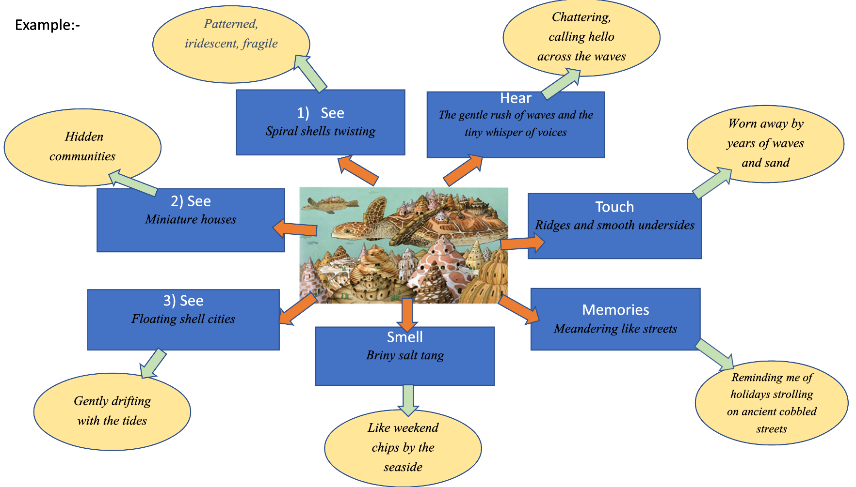

Slide 10
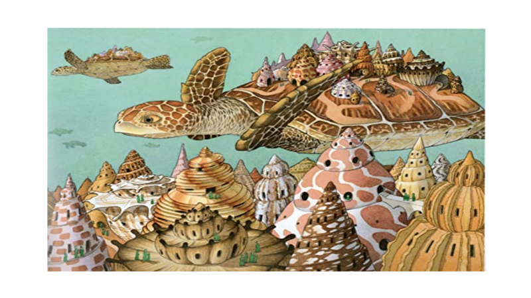

Slide 12
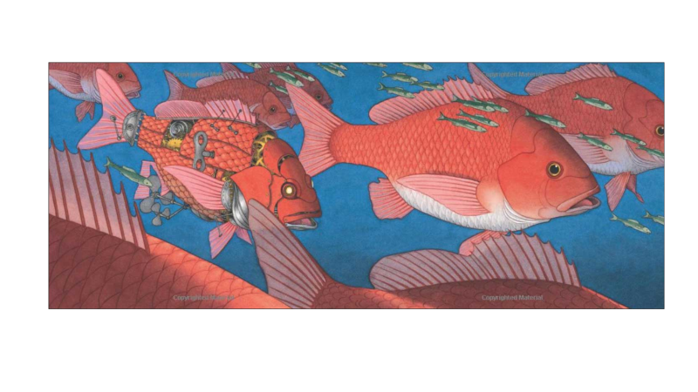

Slide 14
